Slide 1
Observation activity

Slide 2
How Observant Are You?
This activity demonstrates our ability to remember details accurately. Testimony about personal experiences is frequently used during an investigation, and can even make or break a case.
How accurately do people remember what they have seen?
What factors may play a role in what we can remember and describe about something we have witnessed?
Consider these questions on the next slide as you do the following activity.

Slide 3
Directions:
Observe the picture for exactly 30 seconds. Look at everything you think might be important.
After 30 seconds, answer the questions on the next page on a sheet of paper. (Do not read the questions before you look at the picture!)
How observant were you? Compare your answers to the picture.

Slide 4
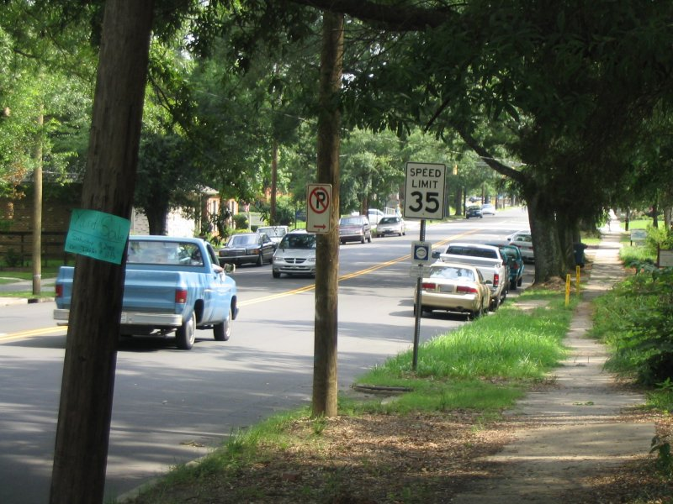

Slide 5
Observation Questions - Picture
Are there cars parked on the sides of the road?
What color is the pickup truck driving in the road?
Any minivans around?
What does the blue sign say?
What's the speed limit?
Are there any pedestrians on the road?

Slide 6
How Observant are Other People?
In the last exercise you may have forgotten some details, and remembered other things incorrectly. As you experienced, your own memory can sometimes fool you.
But what about other people's memories? Try out these exercises to see how witnesses to the same scene remember different details.
Think about how useful an individual's testimony can be. Does it help to have several witnesses to a scene?

Slide 7
Directions:
Choose several people to be observers and choose two people to be investigators.
Allow the observers to look at the picture or this picture for 30 seconds. The investigators should not look at the picture.
After 30 seconds, the investigators should begin questioning the observers. Each Investigator should question each observer. Then, the Investigators should attempt to reconstruct the scene based on the "eyewitness testimony".

Slide 8
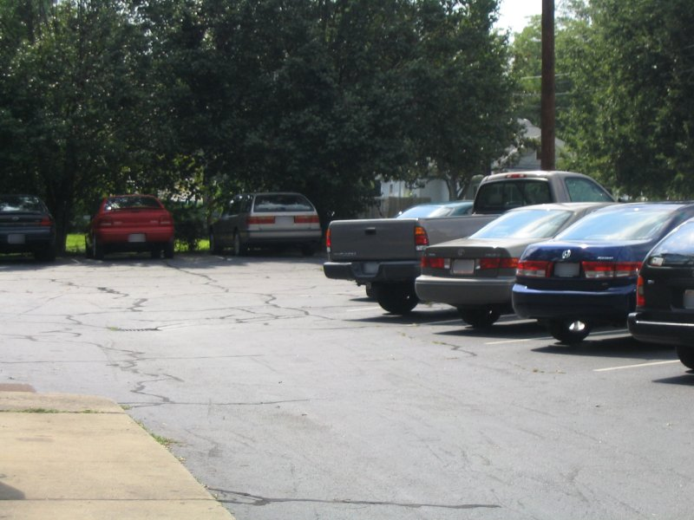

Slide 9
Questions for Investigators
Investigators can use these questions to guide their inquiry, but may also think of their own questions.
About how many cars can you see?
Can you describe some of the cars in the lot?
7
Answer: grey Toyota Tundra pickup, blue Honda Accord sedan, grey Toyota Camry sedan, grey Honda Accord wagon, red Dodge Neon sedan

Slide 10
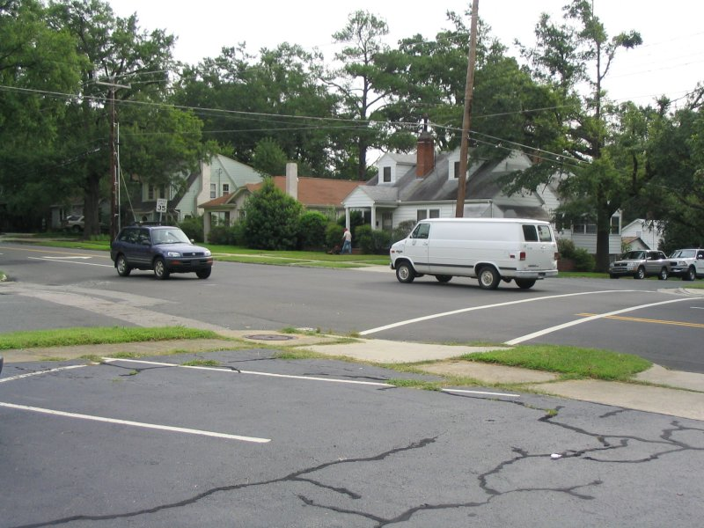

Slide 11
Questions for Investigators
How many cars were in the intersection?
Across the street, are there any parked cars on the side?
Can you describe at least one of the cars driving through the intersection?
Are there any other potential witnesses?
What was this witness doing?
What was the speed limit?
Was there anyone parked in the first parking spot?
Answer: 2
Yes
Yes
They should have noticed a person mowing a lawn across the street.
35
No

Slide 12
What influences our observations?
Watch the commercial provided by the teacher.
Answer the questions on the sheet provided.

Slide 13
https://www.youtube.com/watch?v=_7bIFOdc_TQ

Slide 14
Questions
How many people are in the video?
Describe the main character(s) in the commercial in terms of:
Size
Age
Skin color
Height
Weight
Hair: style, color, length
Clothing
Hat
Glasses
Distinguishing features
Jewelry
Beard or no beard
Any physical limitations
Describe the other people in the commercial.
Describe the area where the video was located.
What furniture, if any, was in the commercial?
Was the time noted?
Was it possible to determine the season?
What were the people doing in the commercial?
Were there any cars in the commercial? If so, describe the:
Model
Year
Color
License plate number
How long was the video?

Slide 15
How to be a good observer
Make a conscious effort to examine our environment systematically
At a crime scene, start at one corner and run your eyes slowly over the place looking at everything you see.
Consciously decide to observe everything, no matter how small or how unfamiliar, no matter what our emotions or previous experiences.
This prevents the brain from filtering out ‘unimportant’ information without your awareness.
Concentrate first and foremost on gathering all of the available information and leaving the interpretation until we have as much information as possible.
This prevents the brain from interpreting what we see by finding patterns and making connections.
Write down and photograph as much information as possible.
Our memories are faulty and physical documentation is important in admitting evidence into court.

