Slide 1
Topic 8: Acids and Bases
Topic 8.3: The pH scale is an artificial scale used to distinguish between acid, neutral, and basic/alkaline solutions
Topic 8.4: The pH depends on the concentration of the solution. The strength of acids or bases depends on the extent to which they dissociate in aqueous solution.

Slide 2
Important terms for these sections
Section 8.4:
Strong acid
Weak acid
Strong base
Weak base
Section 8.3:
pH meter
Ionic product constant of water

Slide 3
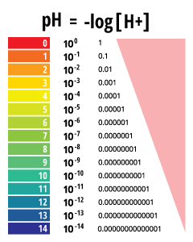
The pH is a logarithmic expression of H⁺
Using the actual concentration of H⁺ is unrealistic as it is so very tiny!
pH = -log₁₀[H⁺]
Or [H⁺] = 10^{-pH}
Examples:
A solution [H⁺] = 0.1 mol dm⁻³ → [H⁺] = 10⁻¹, so the pH = 1
A solution [H⁺] = 0.01 mol dm⁻³ → [H⁺] = 10⁻², so the pH = 2

Slide 4
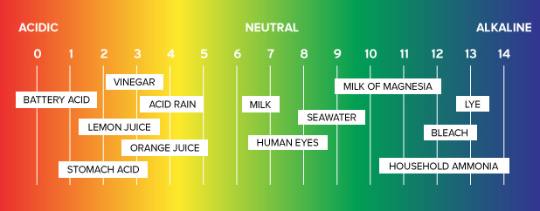
The pH is a logarithmic expression of H⁺
pH has no units and are typically positive (easy!)
Usually all bases and acids fall within the 0-14 range on the pH scale
pH is also inversely related to the [H⁺]
This means that the higher the [H⁺], the lower the pH
acids tend to be lower than 7
Bases tend to be higher than 7
Thus, a change in pH unit of 1 is a 10-fold change in [H⁺]

Slide 5
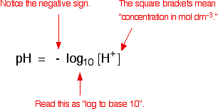
The pH calculations
Knowing the definition of pH we can:
Calculate the value of pH from a known concentration of H⁺
Calculate the concentration of H⁺ from a given pH
Example:
If the concentration of [H⁺] was determined to be 3.2 x 10⁻⁵ mol dm⁻³, what is the pH?
pH = -log₁₀ [H⁺]
pH = -log₁₀ (3.2 x 10⁻⁵)
pH = -(-4.4945)
pH = 4.49 (this is less than 7, so the sample is acidic)

Slide 6
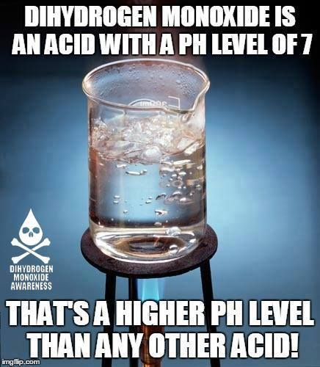
The pH calculations
Example:
Given a pH of 7.40, what is the concentration of H⁺?
[H⁺] = 10^{-pH}
[H⁺] = 10^{-7.40}
[H⁺] = 4.0 x 10⁻⁸ mol dm⁻³

Slide 7
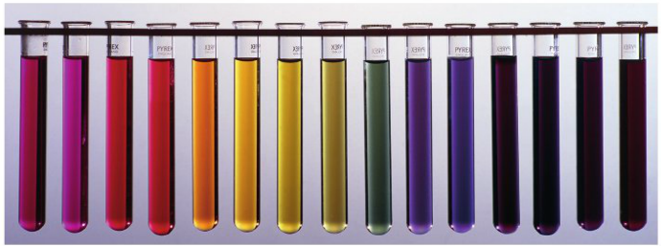
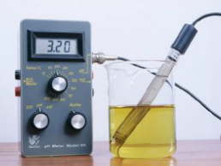
Measuring pH
Using indicators is a good way to measure pH
Indicator must have a narrow color range for best results
Is more qualitative than quantitative
pH meter is better for accurate results
Uses an electrode to measure [H⁺] directly
Must calibrate with buffer solutions
Must standardize for temperature

Slide 8
Ionization of water
Water ionizes a little bit
You would expect that the equilibrium would lie to the left and is considered a constant, K_{w}, since it only ionizes a little bit
So K_{c} = K_{w}

Slide 9
The relationship between H⁺ and OH⁻ is inverse
[H⁺] x [OH⁻] gives a constant value
Which means they are inversely related
So for pure water, [H⁺] x [OH⁻] = K_{w}

Slide 10
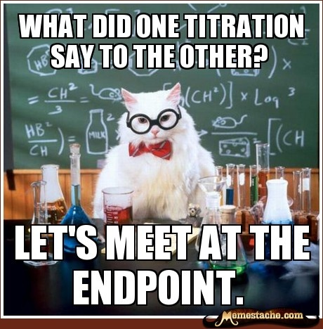
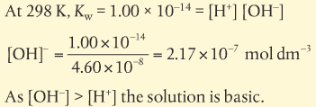
The relationship between H⁺ and OH⁻ is inverse
[H⁺] x [OH⁻] gives a constant value
Example: given [H⁺] = 4.60 x10⁻⁸ mol dm⁻³
What is [OH⁻]?

Slide 11
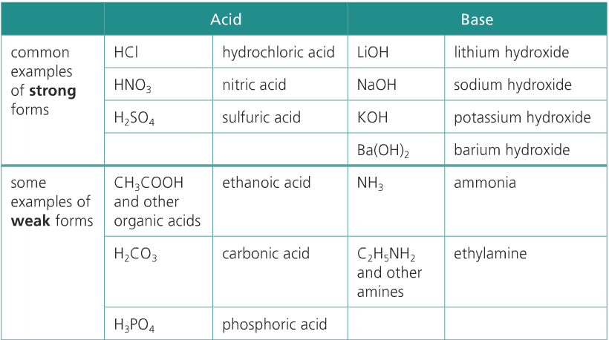
8.4: strong and weak acids and bases
Strength of the acid/base depends on the extent of ionization
Unfortunately, some of this is memorization as to which common acids/bases are strong/weak

Slide 12
8.4: strong and weak acids and bases
Strong acids
Since they dissociate almost completely, there is only one directional yield sign
Good proton donor
Weak acids
Only dissociate partially, so both directional arrows are present (equilibrium)
Poor proton donor
Weak base
Strong base

Slide 13
8.4: strong and weak acids and bases
Strong acids
Products are favored
Weak acids
Reactants are favored
Thus, for acids, the weaker conjugate base is favored overall
Weak base
Strong base

Slide 14
8.4: strong and weak acids and bases
Strong bases
Since they dissociate almost completely, there is only one directional yield sign
Good proton acceptor, produces conjugate acids that are weak or have no acidic properties
Weak bases
Only dissociate partially, so both directional arrows are present (equilibrium)
Poor proton acceptor, produces strong acid conjugates
NOTE: strength and concentration are not the same thing!!!
Weak acid
Strong acid

Slide 15
Weak acids/bases more common than strong

Slide 16
Distinguishing between strong/weak acids/bases
Strength of acids/bases depends on their dissociation in solution
Strong will have a higher [H⁺] and [OH⁻] than weak
Electrical conductivity – compare same concentration
Since there are more moving charges (ions), there is higher conductivity for stronger acids/bases
Rate of reaction
Reactions with strong acids will occur faster due to the higher concentration of [H⁺]
Not helpful in lab except for safety (nitric acid is nasty stuff!!)
pH – compare same concentration
Great way to compare strength of acids
Higher [H⁺] the lower the pH value
Use universal indicator or pH meter

