Slide 1
Topic 8: Acids and Bases
Topic 8.1: Many reactions involve the transfer of a proton from an acid to a base.
Topic 8.2: The characteristics of an acid depends on empirical evidence such as the production of gases in reactions with metals, the color changes of indicators, or the release of heat in reactions with metal oxides and hydroxides.

Slide 2
Important terms for these sections
Section 8.2:
Alkalis
Salt
Parent acid
Parent base
Spectator ions
Neutralization
Enthalpy of neutralization
Acid-base indicators
Litmus
Universal indicator
Acid-base titration
Equivalence point
Section 8.1:
Brønstead-Lowry Theory
Proton acceptor
Proton donor
Conjugate acid-base pair
Amphiprotic

Slide 3
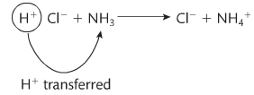
Theories of acids and bases
Water dissociates to form H⁺ and OH⁻
When H loses an electron, it only has a proton left
H⁺ is also called a proton
H₃O⁺ is a hydrated proton also used interchangeably
Called hydronium ion, oxonium ion, or hydroxonium ion
Brønstead-Lowry Theory
Is the theory of proton transfer
Acids donate H⁺
Bases accept H⁺

Slide 4
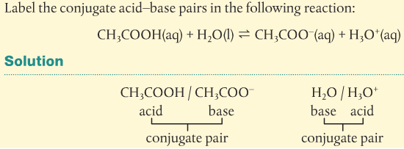
Theories of acids and bases
Conjugate pairs
Given a generic acid-base reaction:
HA + B ⇌ A⁻ + BH⁺
HA acts as an acid and donates a proton
B acts as an acid and accepts a proton
An example found in all aqueous solutions:
Example:

Slide 5
Theories of acids and bases
Amphiprotic species
Can act as an acid or as a base depending on with what it is reacting
Most common is water and HCO₃⁻
So looking at the definition of Brønstead-Lowry acids and bases
Acids have to have a proton to donate
Basses have to have a lone pair of electrons to accept the proton
Therefore, amphiprotic species must have both a proton to donate and a lone pair of electrons

Slide 6
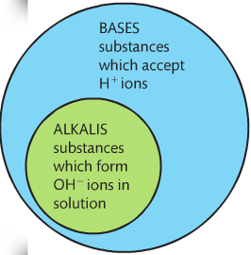
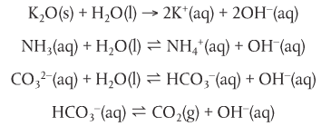
8.2: properties of acids and bases
Acids react with bases known as alkalis
They come in several forms
These all release OH⁻ ions

Slide 7
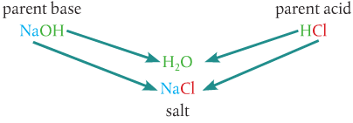
Acids react with metals, bases, and carbonates to form salts
Salts (ionic compound) are formed when H is replaced by a metal or another positive ion
3 types of these reactions:
Acid + metal → salt +hydrogen
acid + base → salt + water
Acid + carbonate → salt + water + carbon dioxide

Slide 8
1. Acids react with metals
Acid + metal → salt +hydrogen
There are spectator ions!
So the overall net ionic equation is what?
These reactions are the reason metals corrode with acid
Alkali metals react more violently: Li, K, Na
Transition metals usually do not: Cu, Ag, Au

Slide 9
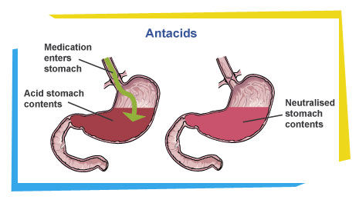
2. Acids react with bases
acid + base → salt + water
These are neutralization reactions
Weak reactions are used as antacids
Have an enthalpy of neutralization = exothermic!
Since they share a basic net ionic equation:
They also have ∆H ~57 kJ mol⁻¹

Slide 10
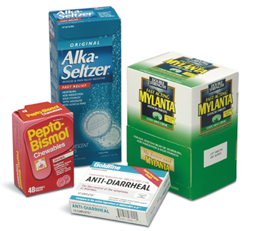
3. Acids react with carbonates
Acid + carbonate → salt + water + carbon dioxide
Also used in some antacids
These produce CO₂ gas = effervescence
Plop, plop, fizz, fizz, oh! What a relief it is!
http://media.pearsoncmg.com/intl/ema/9781447959762_ChemHL_Brown_Ford/animations/Chapter8p363/index.html
Net ionic equation for these reactions:

Slide 11
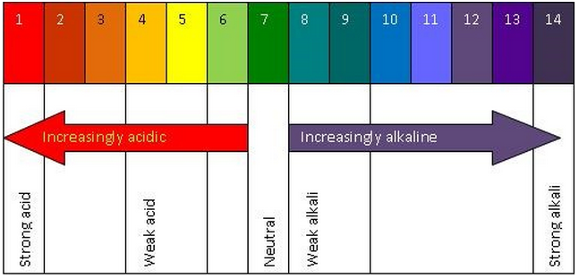
Acids and bases can be distinguished using indicators
Colors change reversibly according to the concentration of H⁺ ions
The conjugates have different colors
Litmus changes blue in base and red in acid
Derived from lichens
Not that useful if you are trying to find a specific pH
Universal indicator is the bomb!!
https://youtu.be/PdprNTwb4Ks

Slide 12
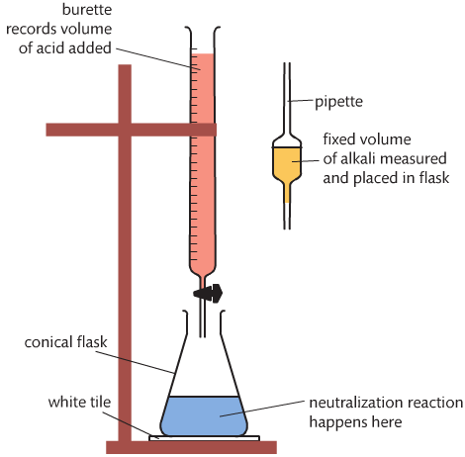
Acid-base titrations are based on neutralization reactions
Acid-base titrations:
Known concentration and volume of 1 solution
Know volume added to neutralize the other solution
Solve for the unknown concentration
Equivalence point is where the concentration one solution neutralizes the other
You need to choose an indicator that changes as close (sharp change) to the equivalence point as possible

