Slide 1
Topic 8: Acids and Bases
Topic 18.3: pH curves can be investigated experimentally but are mathematically determined by the dissociation constants of the acid and base. An indicator with an appropriate end point can be used to determine the equivalence point of the reaction.
Topic 8.5: Increased industrialization has led to greater production of nitrogen and sulfur oxides leading to acid rain, which is damaging our environment. These problems can be reduced through collaboration with national and intergovernmental organizations.

Slide 2
Important terms for these sections
pH curves
Point of inflection
Half equivalence
Buffer region
Change point
End-point
End-point range
Section 18.3:
Buffer solution
Acidic buffer
Basic buffer
Buffering capacity
Burette
Pipette
Equivalence point/stoichiometric point
Section 8.5:
Acid rain
Acid deposition
Leaching
Eutrophication
Hydrodesulfurization
Flue-gas desulfurization

Slide 3
Buffer solutions
Buffer solutions are resistant to changes in pH when small amounts of acids or alkalis are added
Water is sensitive to changes (non-buffered solution)
But since water is vital to biological functions, how is homeostasis maintained?
Buffer systems are so important
Buffers can maintain pH at any particular pH although
Most biological ones are around 7
Ocean water is about 8-9

Slide 4
Acidic buffers
Composition of acidic buffer solution:
Mix a weak acid with a solution of its salt of a strong alkali
Example: CH₃COOH(aq) and CH₃COONa(aq)
There is a high level of both the acid and its conjugate base = RXTs with extra OH⁻ and H⁺
http://media.pearsoncmg.com/intl/ema/9781447959762_ChemHL_Brown_Ford/animations/Chapter8p392/index.html

Slide 5
Acidic buffers
Adding H⁺:
CH₃COO⁻ will RXT with H⁺ to form CH₃COOH removing the protons from solution
Adding OH⁻:
CH₃COOH will RXT with OH⁻ to form CH₃COO⁻ and H₂O removing hydroxide ions from solution

Slide 6
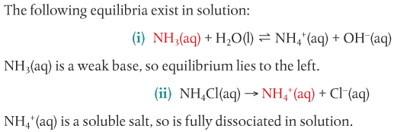
Basic buffers
Composition of basic buffer solution:
Mix a weak base solution with its salt of a strong acid
Example: NH₃(aq) and NH₄Cl(aq)
There is a high level of both the base and its conjugate acid = RXTs with extra OH⁻ and H⁺

Slide 7
basic buffers
Adding H⁺:
NH₃ will RXT with H⁺ to form NH₄⁺ removing the protons from solution
Adding OH⁻:
NH₄⁺ will RXT with OH⁻ to form NH₃ and H₂O removing most of the hydroxide ions from solution

Slide 8
Buffer summary and how to make buffer solutions
In summary: Buffer solutions contain a mixture of an acid and a base of a weak conjugate pair
The buffer’s acid neutralizes the added alkali
The buffer’s base neutralizes the added acid
Thus, pH change is resisted
How to make buffers: the interactions of the components determines the pH =
1. the pKa or pKb of the acid or base
2. the ratio of initial concentrations of acid and salt, or base and salt, used in its prep

Slide 9
Buffer summary and how to make buffer solutions
How to make buffers: the interactions of the components determines the pH
1. the pKa or pKb of the acid or base
2. the ratio of initial concentrations of acid and salt, or base and salt, used in its prep
Should start with an acid or base with pKa or pKb with pH close to desired pH or pOH of the buffer
Then, mixed with sol’n of salt containing its conjugate
OR partially neutralized by strong acid or base
For neutralization, make sure that ½ of the starting acid or base is converted to salt
Then the mixture will contain unreacted acid or base and its salt in equimolar amounts

Slide 10
Factors influencing buffers
1. Dilution
Ka and Kb are not changed by dilution
Ratio of acid or base to salt concentration is the same (decreased by same amount)
Dilution does not change pH
2. Temperature
Changes the Ka and Kb therefore will also affect pH of the buffer
This is also important when dealing with biological procedures (i.e. involving blood)

Slide 11
Salt hydrolysis
Salt is a product of neutralization reaction
Cation is conjugate acid of parent base
Anion is conjugate base of parent acid
Not all salts form neutral solutions
The pH depends on the ions formed (conjugate acids and bases strength)
If the conjugate acid is strong, the pH may be lower
If the conjugate base is strong, the pH may be higher

Slide 12
Salts
Strong acid – strong base Salt: neutral pH (close to 7) at 298K
Both conjugates are weak
Weak acid – strong base salt: pH is greater than 7 at 298K
Conjugate base of weak acid is strong
Strong acid – weak base salt: pH is less than 7 at 298K
Conjugate acid of weak base is strong
Weak acid – weak base salt: Depends on Ka and Kb of the acids and bases involved
Both conjugates are strong

Slide 13
Salt summary

Slide 14
Acid-base titrations
Some controlled amount of 1 solution of known concentration is added to a known amount of the other solution
Acid and base reaction occurs will equivalence point is reached
Use pH meter or indicator to determine exact point of neutralization
The change in pH during a neutralization is not linear (due to the logarithmic nature)
At equivalence point, the acid and base are neutralized so only salt and water are remaining in solution
http://media.pearsoncmg.com/intl/ema/9781447959762_ChemHL_Brown_Ford/animations/Chapter8p398/index.html

Slide 15
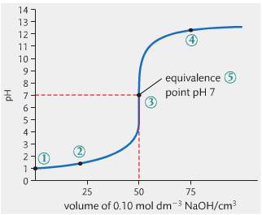
Acid-base titrations
Strong acid and strong base
1. initial pH = 1 (strong acid)
2. pH changes gradually until equivalence
3. very sharp jump from pH 3 – 11 = equivalence
4. after equivalence, graph levels out at high pH
5. pH at equivalence = 7

Slide 16
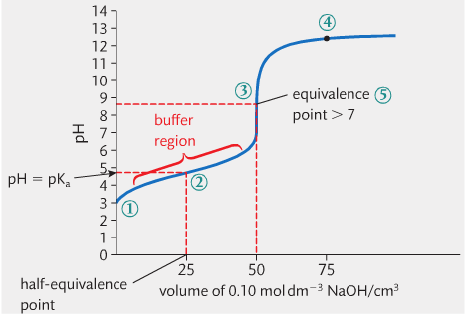
Acid-base titrations
weak acid and strong base
1. initial pH is fairly high (weak acid)
2. pH stays relatively same until equivalence – labelled as a buffer region
3. pH jumps from 7 – 11 which is a smaller jump than with strong acids/bases
4. curve flattens at high value (strong base so higher pH)
5. pH at equivalence is >7

Slide 17
Acid-base titrations – weak acid/strong base
The half equivalence point
Point on graph where half the acid has been neutralized by base
Has ½ salt from reaction and ½ unreacted weak acid = buffer!!!
The pH in this region shows resistance in change due to this property
pKa can be calculated from this point b/c [acid] = [salt]
pKb can be calculated if weak base and strong acid RXT

Slide 18
Acid-base titrations
Strong acid and weak base
1. initial pH is fairly low (strong acid)
2. pH stays relatively same through buffer region to equivalence point
3. pH jumps from 3 – 7 which is a smaller jump than with strong acids/bases
4. curve flattens at fairly low value (strong acid so higher pH)
5. pH at equivalence is <7

Slide 19
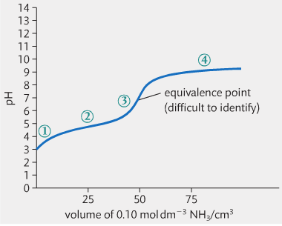
Acid-base titrations
weak acid and weak base
1. initial pH is fairly high (weak acid)
2. addition of base causes pH to rise steadily
3. change in pH at equivalence point is less sharp than other graphs
4. curve flattens at fairly low value (pH of weak base)

Slide 20
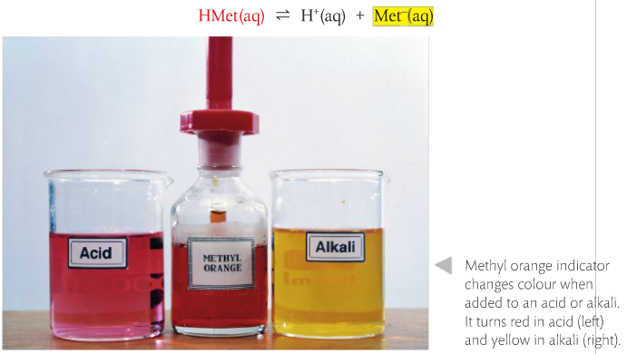
Indicators signal change in pH
Indicators are weak acids or weak bases that change color based on the pH of the solution
Using leChatelier’s principle (equlibirum stuff)
Example:

Slide 21
Indicators signal change in pH
Indicators change color when the pH is equal to their pKa
End-point or change point: color change point of the indicator
What determines the end-point of the indicator?
When the [acid] = [conjugate base] the indicator is exactly in the middle of color change
Adding a small amount of acid or base will shift the equilibrium just enough to cause the color change
See section 22 of the data booklet

Slide 22
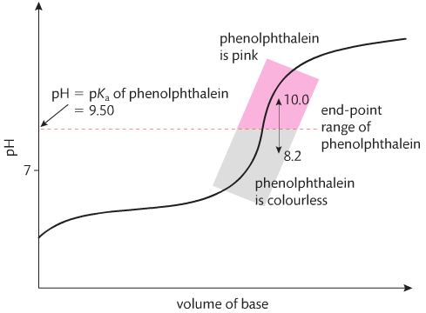
Indicators signal change in pH
Indicators can be used to signal the equivalence point in titrations
You should pick an indicator that has an end-point that matched the equivalence point of the reaction
1. determine what combo of weak and strong acids and bases are reacting
2. deduce the pH of the salt solution at equivalence from the nature of the parent acid and base
3. choose an indicator with an end-point in the range of the equivalence point by consulting the data tables

Slide 24
8.5: acid deposition
The causes of acid deposition
Water is naturally acidic: carbonic acid
Acid rain, pH 5.6 or lower
Often oxides of sulfur and nitrogen also in rain to create more acidity (pollutants)
Acid deposition: all processes where acidic components leave the atmosphere (as gas or precipitate)
Wet acid deposition: rain, snow, sleet, fall to ground as aqueous precipitates
Dry acid deposition: acidifying particles, gases fall to ground as dust or smoke then dissolve in water to form acids

Slide 25
Sulfur oxides
SO₂ is produced from burning coal and heavy oil
It is converted to SO₃ in the air and can mix with water to make H₂SO₄
This conversion happens a few different ways but the one below is described in the text

Slide 26
Nitrogen oxides
NO and NO₂ are primarily produced from internal combustion engines (cars, boats, etc.)
Dissolving these in water created nitric acid, HNO₃
The following mechanism is also possible:

Slide 27
Acid deposition

Slide 28
Effects of acid deposition
Impacts on materials
Limestone and marble are made of CaCO₃
Both SO₂ and H₂SO₄ can make the material softer by making CaSO₄ (similar reaction with HNO₃)
The CaSO₄ can be washed away more easily and also expands causing stress on the stonework
Erosion is the lesson here, folks
Also metal corrosion occurs

Slide 29
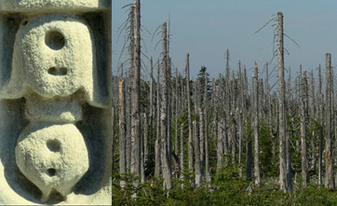
Effects of acid deposition
Impact on plant life:
Slower growth, injury, death in plants due to:
leaching – removal of Mg²⁺, Ca²⁺ and K⁺ from soil
Toxicity – addition of Al³⁺ damages roots, dry deposition blocks stomata (gas exchange)
Worst affect areas: forests in hilly regions (clouds and mists) esp. in England
Impact on water:
Can kill lakes – unable to support life as the pH is below 4-5
Al³⁺ trapped in rock ends up being released and fish gills cannot function to take in O₂
eutrophication – over-fertilization or nitrates in acid rain added to bodies of water can cause algal blooms = O₂ depletion
Impact on humans:
Inhalation of sulfate and nitrate particles can cause irritation of respiratory tract and eyes
Release of metals into water can also cause health problems

Slide 30
Responses to acid deposition
Reduction of SO₂ emissions
1. pre-combustion
Reduce/remove sulfur in coal/oil before burning
Metal sulfide can be removed with water washing
Hydrodesulfurization is catalytic and removes sulfur from refines petroleum products by reacting H₂ to make H₂S
H₂S is captured and used to make H₂SO₄
2. post-combustion
Flue-gas desulfurization can remove up to 90% of SO₂ from flue gas in smoke from coal power stations
Uses wet slurry of CaO and CaCO₃ to form a neutral salt CaSO₄ (used to make plasterboard)

Slide 31
Responses to acid deposition
Reduction of No_{x} emissions
1. catalytic converters in vehicles
Gases mixed with air are passed over platinum or palladium-based catalyst
2. lower temperature combustion
Forming NO is reduced at a lower temp (chapter 7)
Recirculating exhaust gases back into the engine lowers the temp to reduce NO emissions
Other options
Lower demands for fossil fuels
Use CaO or Ca(OH)₂ to neutralize acid in bodies of water

