Slide 1
Topic 8: Acids and Bases
Topic 18.1: the acid-base concept can be extended to reactions that do not involve proton transfer
Topic 18.2: The equilibrium law can be applied to acid-base reactions. Numerical problems can be simplified by making assumptions about the relative concentrations of the species involved. The use of logarithms is also significant here.

Slide 2
Important terms for these sections
Section 18.2:
pOH scale
pK_{w}
K_{a} Acid dissociation constant
K_{b} base dissociation constant
pK_{a}
pK_{b}
Section 18.1:
Lewis acid
Lewis base
Coordinate bond
Nucleophile
Electrophile

Slide 3
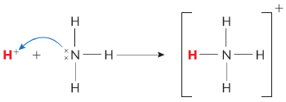
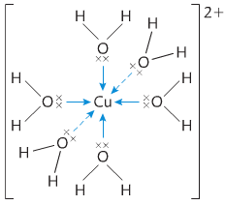
Lewis acids and bases
Lewis theory – Broader definition than b-l theory
Focuses on electron pairs instead of a proton transfer
Related to Lewis dot structures!
Lewis acid = a lone pair acceptor (wants to bond with a lone pair)
Lewis base = a lone pair donor (has a one pair to donate)
By this definition, all the acid-base reactions will result in a coordinate bond!
Transition metals also make good Lewis acids since they form coordinate bonds

Slide 4
Nucleophiles and electrophiles
Nucleophiles “like nucleus”
has electrons to donate to create new covalent bond
Lewis base
Electrophile “likes electrons”
electron-deficient to accept lone pair to form covalent bond
Lewis acid

Slide 5
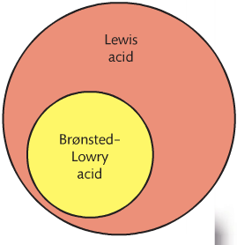
Comparison of Brønstead-Lowry and Lewis theories of acids and bases
Brønstead-Lowry acids are also Lewis acids
Not all Lewis acids are Brønstead-Lowry acids
Brønstead-Lowry usu describes H⁺ species
Those without H⁺ use Lewis description
Same with the reactions
If there is no H⁺ transfer, it must be described in terms of Lewis

Slide 6
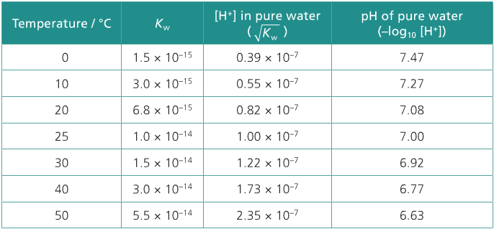
18.2: Calculations involving acids and bases
Remember that K_{w} is temperature dependent
[H⁺] [OH⁻] = K_{w} = 1.00 x10⁻¹⁴ mol dm⁻³ at 298K
When the temp increases:
Equilibrium shifts to right
Concentrations are still equal
pH decreases b/c the [H⁺] increases
When temp decreases
Equilibrium shift to left more = H₂O
Lower [H⁺] so pH goes

Slide 7
pH and pOH scales are inter-related
Like the pH scale, the pOH scale is similar to compare the concentrations of OH⁻
BUT As the concentration of OH⁻ goes up, the pH goes up because the [H⁺] would be going down

Slide 8
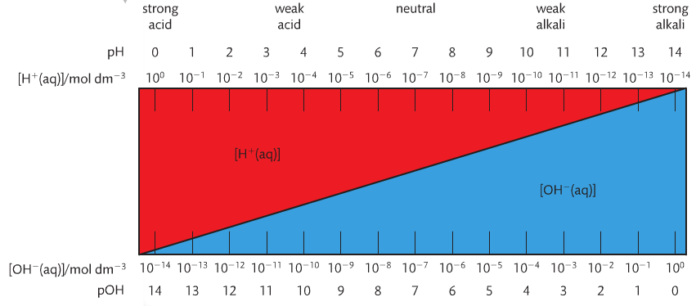
pH and pOH scales are inter-related

Slide 9
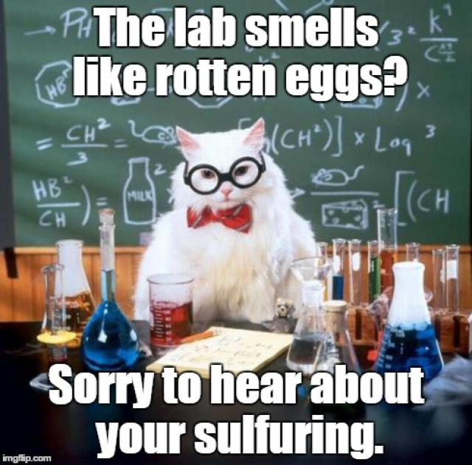
pH and pOH scales are inter-related
When you see something like: pK_{w}, the p means “take the –log₁₀”
so:
And so pertaining to all temps, we can write: pH + pOH = pK_{w}

Slide 10
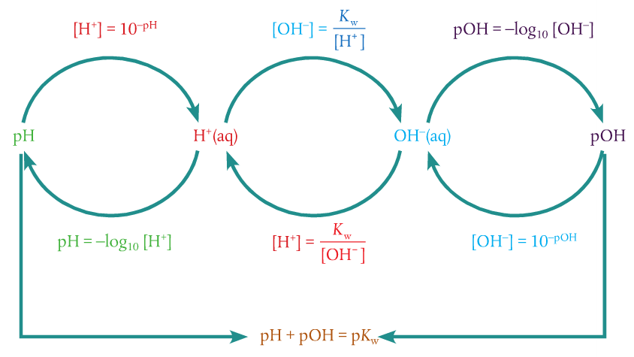
In summary:

Slide 11
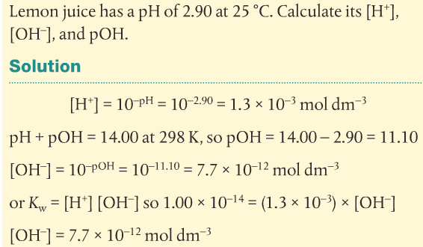
Converting H⁺ AND oh⁻ TO pH and pOH
pOH can be converted with concentrations of [OH⁻]
In the same way that pH is converted

Slide 12
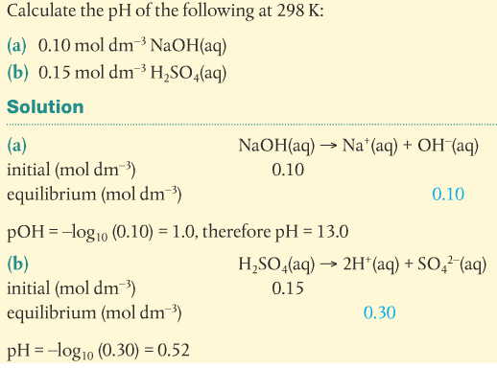
Strong acids and bases: pH and pOH can be deduced from their concentrations
Since these dissociate fully, we can calculate the concentration of the ions

Slide 13
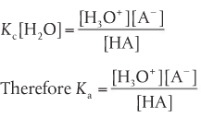
Dissociation constants express the strength of weak acids and bases
Weak acids and bases do not dissociate fully
So we have to use another way: such as the equilibrium equation
Since the concentration of water is constant, we can create another equilibrium constant from K_{c} for weak acids: K_{a}
This is called the acid dissociation constant
The higher the K_{a}, the stronger the acid
This is an equilibrium constant so only T affects it

Slide 14
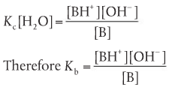
Dissociation constants express the strength of weak acids and bases
We can see the same concept with bases to give the base dissociation constant
This is also an equilibrium constant, Kb so will be affected by temp

Slide 15
Calculations involving K_{a} and K_{b}
The given concentration of an acid or base is its initial concentration – before dissociation occurs
The pH (or pOH) of a solution refers to the concentration of h⁺ ions (or OH⁻ ions) at equilibrium
The concentration values substituted into the expression for K_{a} and K_{b} must be the equilibrium values for all reactants and products
When the extent of dissociation is very small (very low value for K_{a} and K_{b}) it is appropriate to use the approximations:

Slide 16
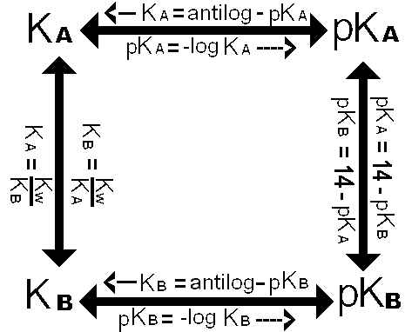
Calculations involving K_{a} and K_{b}
1. calculation of K_{a} and K_{b} from pH and initial concentration
2. calculation of [H⁺] and pH, [OH⁻] and pOH from K_{a} and K_{b}

Slide 17
Calculations involving K_{a} and K_{b}
1. calculation of K_{a} and K_{b} from pH and initial concentration
Example: calculate K_{a} at 298K for a 0.01 mol dm⁻³ solution of ethanoic acid. It has pH of 3.4 at this temperature.
SOLUTION: start with writing the equation dissociation for the acid
pH 3.4 = [H⁺] = 10^{-3.4} → 4.0 x10⁻⁴ mol dm⁻³ this is the final [H⁺]
Then, this is an I.C.E. problem!

Slide 18
Calculations involving K_{a} and K_{b}
2. calculation of [H⁺] and pH, [OH⁻] and pOH from K_{a} and K_{b}
Example: a 0.75 mol dm⁻³ solution of ethanoic acid has a K_{a} = 1.8 x 10⁻⁵ at a specific temp. what is the pH?
Solution: to find pH, we know what [H⁺] is at equilibrium
So the change in [CH₃COOH] = -x
Changes in [CH₃COO⁻] and [H⁺] = +x

Slide 19
Calculations involving K_{a} and K_{b}
2. calculation of [H⁺] and pH, [OH⁻] and pOH from K_{a} and K_{b}
Example: a 0.75 mol dm⁻³ solution of ethanoic acid has a K_{a} = 1.8 x 10⁻⁵ at a specific temp. what is the pH?

Slide 20
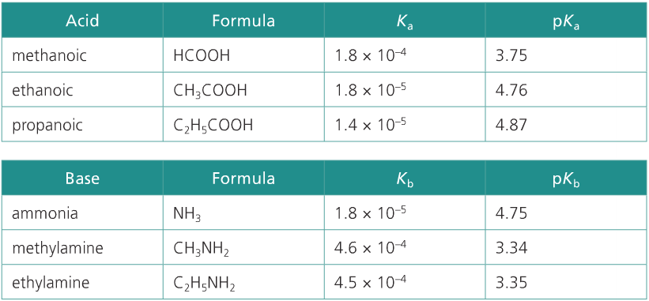
pK_{a} and pK_{b}
1. pK_{a} and pK_{b} numbers are usually positive and have no units
2. the relationship between K_{a} and pK_{a} and between K_{b} and pK_{b} is inverse
3. a change of 1 unit in pK_{a} or pK_{b} represents 10-fold change in the value of K_{a} or K_{b}
4. pK_{a} or pK_{b} must be quoted at a specific temperature

Slide 21
pK_{a} and pK_{b}
1. pK_{a} and pK_{b} numbers are usually positive and have no units
And are best used for weak acids and bases
2. the relationship between K_{a} and pK_{a} and between K_{b} and pK_{b} is inverse

Slide 22
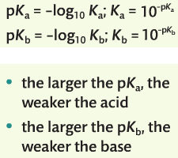
3. a change of 1 unit in pK_{a} or pK_{b} represents 10-fold change in the value of K_{a} or K_{b}
4. pK_{a} or pK_{b} must be quoted at a specific temperature
Since they are derived from equilibrium constants

Slide 23
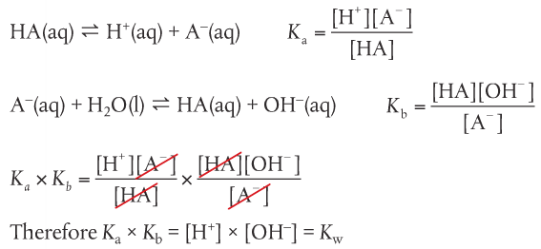
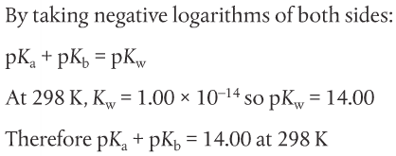
Relationship between K_{a} and K_{b}, pK_{a} and pK_{b} for a conjugate pair
This relationship is true for all conjugate acid-base pairs in solution
This shows that for higher K_{a}, the lower the K_{b}
Stronger acids have weaker conjugate bases and vice versa

Slide 24
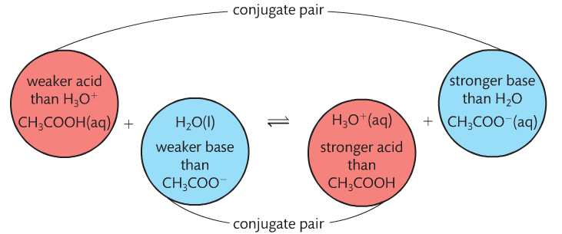
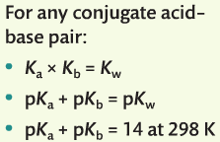
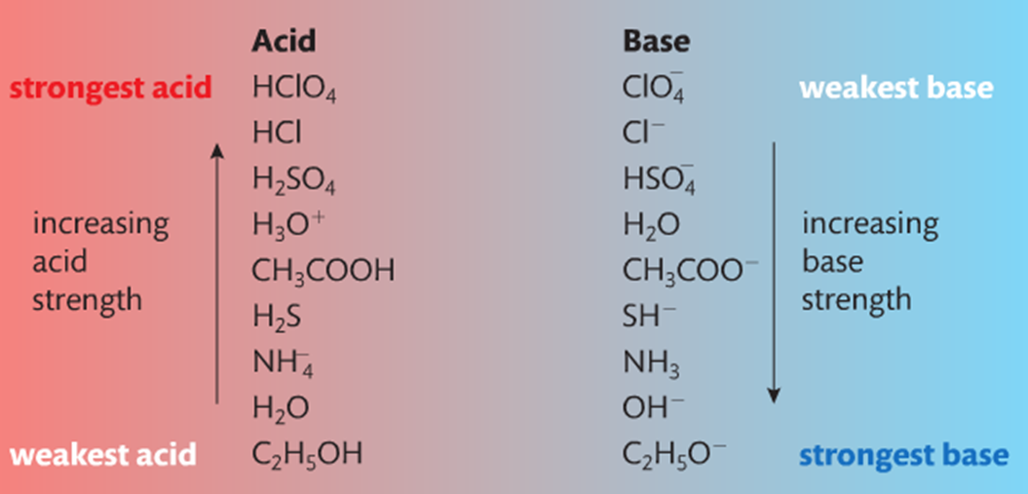
Relationship of parent and conjugates

