Slide 1
Introduction to forensic science
Definitions and Background
“Truth is incontrovertible.
Panic may resent it
Ignorance may deride it
Malice may distort it
But here it is.”
—Winston Churchill

Slide 2
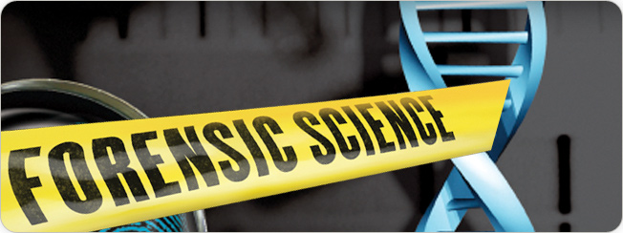
What is forensic science?
The study and application of science to matters
of law
Includes the business of providing timely, accurate, and thorough information to all levels of decision makers in our criminal justice system
The word forensic is derived from the Latin forensis meaning forum, a public place where, in Roman times, senators and others debated, performed, and held judicial proceedings.

Slide 3
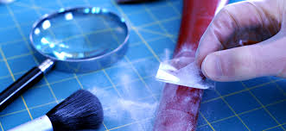
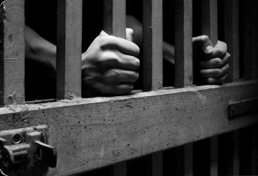
Criminalistics vs. Criminology
Criminalistics
The scientific examination of physical evidence for legal purposes
Criminology
Includes the psychological angle: studying the crime scene for motive, traits, and behavior that will help to interpret the evidence

Slide 4
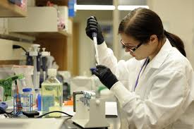
Crime Lab Services
Crime labs can be government-run at the federal, state, or local level, or they can be private consulting businesses.
Most Lab Services:
Optional Services:
Physical science unit
  Chemistry
  Physics
  Geology
Biology unit
Firearms and ballistics unit
Document examination unit
Photography unit
The most common types of evidence examined are drugs, firearms, and fingerprints.
Toxicology unit (drug levels in body)
Latent fingerprint unit
Polygraph unit
Voiceprint analysis unit
Evidence collection unit
Engineering

Slide 5
Specialty Services
Forensic pathology (diseases)
Forensic anthropology (human bones)
Forensic entomology (bugs)
Forensic psychiatry (w/ MD)
Forensic odontology (dental)
Forensic engineering
Cybertechnology
Geology
Environmental science
Polynology (pollen)
Polygraphy
Voiceprint analysis

Slide 6


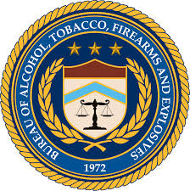



Federal Crime Labs
FBI: Federal Bureau of Investigation
DEA: Drug Enforcement Agency
ATF: Alcohol, Tobacco, and Firearms
USPS: United States Postal Service
U.S. Fish and Wildlife Service
Department of Homeland Security
Department of the Treasury

Slide 7
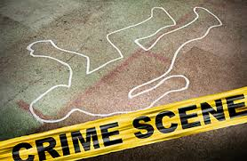
Crime Scene Responders
A group of professional investigators, each trained in a variety of special disciplines
Team members:
  First police officer on the scene
  Medics (if necessary)
  Investigators
  Medical examiner or representative (if necessary)
  Photographer and/or field evidence technician
  Lab experts:
    pathologist serologist (bodily liquids)
    DNA expert toxicologist
    forensic odontologist forensic anthropologist
    forensic psychologist forensic entomologist
    firearm examiner bomb and arson experts
    document and handwriting experts fingerprint expert

Slide 8
Scientific Method
(as it pertains to criminalistics)
Observe a problem or questioned evidence and collect objective data.
Consider a hypothesis or possible solution.
Examine, test, and then analyze the evidence.
Determine the significance of the evidence.
Formulate a theory based on evaluation of the significance of the evidence.

Slide 9
Types of Law
Constitutional law: supreme document and final authority on laws
Statutory law: legislative acts declaring, commanding, or prohibiting something
Common law or case law: body of law made up of judicial opinions or precedents
Civil law: law that deals with noncriminal suits brought to protect or preserve a civil or private right or matter
Criminal law: regulation and enforcement of rights, setting the acceptable limits of conduct in society
Equity law: remedial or preventive (restraining orders)
Administrative law: rules or laws established by agencies such as IRS, SSA, military

Slide 10
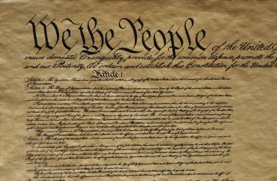
Bill of Rights: gives individuals the right
To be presumed innocent until proven guilty
Not to be searched unreasonably
Not to be arrested without probable cause
Against unreasonable seizure of personal property
Against self-incrimination
To fair questioning by police
To protection from physical harm throughout the justice process
To an attorney
To trial by jury
To know any charges against oneself
To cross-examine prosecution witnesses
To speak and present witnesses
Not to be tried again for the same crime
Against cruel and unusual punishment
To due process
To a speedy trial
Against excessive bail
Against excessive fines
To be treated the same as others, regardless of race, gender, religious preference, country of origin, or other personal attributes

Slide 11
Miranda Rights
The following is a minimal Miranda warning:
You have the right to remain silent. Anything you say can and will be used against you in a court of law. You have the right to speak to an attorney, and to have an attorney present during any questioning. If you cannot afford a lawyer, one will be provided for you at the government’s expense.
How did the Miranda Rights come about?
Ernesto Miranda-sign this, going to jail, court, didn’t know he had those rights. Raped a 10yr old girl in Arizona. Case eventually overturned but he did serve time.

Slide 12
Types of Crimes
Infraction: minor offense or petty crime; penalty is usually a fine
Misdemeanor: minor crime punishable by fine or jail
Felony: major crime punishable by fines and/or more than one year in prison
http://www.colorado.gov/cs/Satellite/CGA-LegislativeCouncil/CLC/1251639217533

Slide 13
Federal Rules of Evidence
In order for scientific evidence to be admitted in a court of law, it must be:
Probative: actually proves something
Material: addresses an issue that is relevant to the particular crime

Slide 14
The Frye Standard: 1923 case ‘Frye v. US’
Scientific evidence is allowed into the courtroom if it is generally accepted by the relevant scientific community. The Frye standard does not offer any guidance on reliability. The evidence is presented in the trial and the jury decides if it can be used.

Slide 15
The Daubert Ruling: 1993 case ‘Daubert v. Dow’
The judge decides if the evidence can be entered into the trial. Admissibility is determined by:
Whether the theory or technique can be tested
Whether the science has been offered for peer review
Whether the rate of error is acceptable
Whether the method at issue enjoys widespread acceptance
Whether the theory or technique follows standards

Slide 16
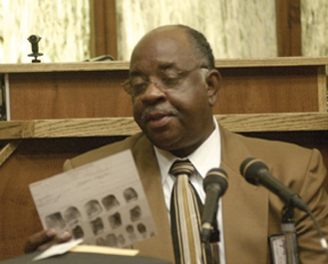
The Expert Witness
The expert witness presents scientific evidence in court. He/She will:
Establish credibility through credentials, background experience.
Evaluate evidence.
Render an opinion about the evidence.
The judge may accept or reject the
opinion’s significance.

Slide 17
Facets of Guilt
To prove a case, the “MMO” must be established; it must be shown that the suspect had:
  Motive—person had a reason to do the crime (not necessary to prove in a court of law)
  Means—person had the ability to do the crime
  Opportunity—person can be placed at the crime scene

Slide 18
Introduction to forensic science
Observation
“Truth is incontrovertible.
Panic may resent it
Ignorance may deride it
Malice may distort it
But here it is.”
—Winston Churchill

Slide 19
Observation is a learned skill of Forensic Investigators
Observation: everything we smell, see, taste, hear, and touch
The brain selects what information gets filtered.
Investigators must observe, interpret, and report observations clearly at the crime scene and examine evidence in the crime lab without making any judgments about its potential importance.

Slide 20
Perception
Our perception is LIMITED and FAULTY
Our brains
  fill in information that is not really there
  Apply knowledge we already have about our surroundings to new situations
Understanding these limitations of the brain helps to improve our observation skills

Slide 21
Eyewitness Accounts
According to The Innocence Project (2008) "Eyewitness misidentification is the single greatest cause of wrongful convictions nationwide, playing a role in more than 75% of convictions overturned through DNA testing." Still, the criminal justice system profoundly relies on eyewitness identification and testimony for investigating and prosecuting crimes (Wells & Olson, 2003).

Slide 22
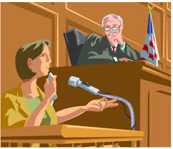
Eyewitness Testimony
Juries heavily influenced by eyewitness identifications.
Lots of innocent people convicted b/c of faulty eyewitness accounts.
Some Issues:
  types of questions asked by investigator
  type of crime
Emotional response improves memory to a certain point
  (Do you remember where you were when 9/11 happened?)
  time frame of questioning after event
  Cross racial identifications difficult

Slide 23
How to be a good observer
Make a conscious effort to examine our environment systematically
  At a crime scene, start at one corner and run your eyes slowly over the place looking at everything you see.
Consciously decide to observe everything, no matter how small or how unfamiliar, no matter what our emotions or previous experiences.
  This prevents the brain from filtering out ‘unimportant’ information without your awareness.
Concentrate first and foremost on gathering all of the available information and leaving the interpretation until we have as much information as possible.
  This prevents the brain from interpreting what we see by finding patterns and making connections.
Write down and photograph as much information as possible.
  Our memories are faulty and physical documentation is important in admitting evidence into court.

Slide 24
What do forensic scientists do?
Find, examine, and evaluate evidence from a crime scene
Forensic scientists have analytical skills such as the ability to observe a situation, organize it into its component parts, evaluate it, and draw appropriate conclusions.

