Slide 1
Chapter 6.1: Collision Theory and Rates of RXN
The greater the probability that molecules will collide with sufficient energy and proper orientation, the higher the rate of reaction.

Slide 2
Important terms for this section
Kinetics
Reaction mechanism
Collision theory
Time
Rate
Rate of reaction
Mol dm⁻³ s⁻¹
Initial rate
Gas syringe
Colorimeter/spectrophotometry
Quenching
Kinetic-molecular theory of matter
Kinetic energy
Absolute temperature
Maxwell-Boltzmann distribution curve
Activation energy
Transition state
Enzyme
Biotechnology

Slide 3
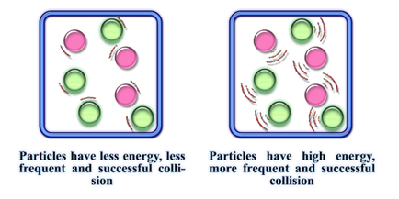
Kinetics
The study of how fast a reaction goes
Reaction mechanism
The sequence of bond breaking and forming
The rate of reaction describes how quickly the reaction happens
Per second or s⁻¹
Described in 2 possible ways:
Decrease of concentration of reactants per second
Increase of concentration of products per second
Thus, change in concentration per unit time = units: mol dm⁻³ s⁻¹

Slide 4
Kinetics
The rate change occurs gradually, so is not a straight line
So to find the rate of a particular reaction at a particular point:
Use a tangent at the point on the curve
See curve of graph?
Indicates that rate is not constant
Rate is fastest at start and tapers off
Tangent to t=0 is initial rate

Slide 5
6 ways to measure rates of RXN (depends on the RXN)
Change in gas (volume) produced
Change in mass
Change in transmission of light: colorimetry/spectrophotometry
Change in concentration measured using titration
Change in concentration measured using conductivity
Non-continuous methods of detecting change during a reaction: ‘clock reactions’

Slide 6
1. Change in volume of gas produced
The production of a calibrated glass syringe to collect released gas or inverted burette.
Burette process can only work if gas has low solubility in water
Measure vol over regular time intervals
Mg(s) + 2HCl(aq) → MgCl₂(aq) + H₂(g)
http://media.pearsoncmg.com/intl/ema/9781447959762_ChemHL_Brown_Ford/animations/Chapter6p281/index.html

Slide 7
2. Change in mass
When a gas is released, the reduction in mass can be measured over a continuous time period
The gas evolved should not be hydrogen (too light to measure mass change)

Slide 8
3. Change in light transmission
If one reactant or product is colored, you can observe the intensity of the color change (continuously) during the reaction
Colorimeter or spectrophotometer is used to observe the change
Works by passing light of specific wavelength through sample/RXN and measures intensity of light passing through
Photocell generates electric current according to amount of light transmitted (passes through) and records on meter/computer

Slide 9
4. Change in concentration measured using titration
It is possible to measure the concentration of a product or reactant by titrating it
CANNOT be measured continuously
Must measure and titrate at several timer periods
Take a sample at a time period, quench the sample reaction and then titrate
Quenching
Cooling
Add an anti-solvent to induce precipitation
Remove solvent by evaporation
Separate layers through liquid-liquid extraction
Purification by chromatography, distillation, recrystaliization
Removal of light or energy source
Common with biochemical tests/assays

Slide 10
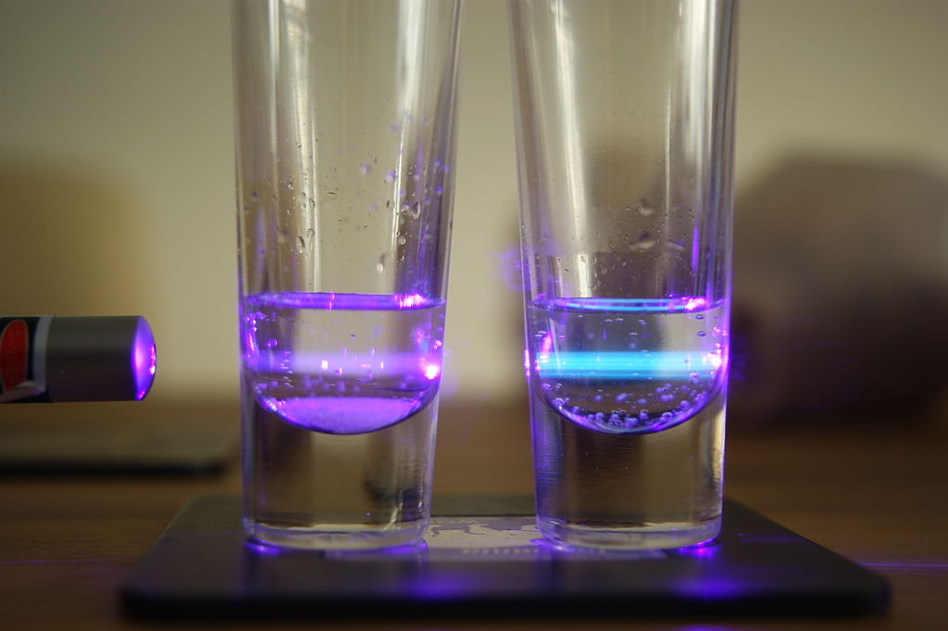
4. Change in concentration measured using titration
Two samples of quinine dissolved in water with a violet laser (left) illuminating both. Typically quinine fluoresces blue, visible in the right sample. The left sample contains chloride ions which quenches quinine's fluorescence, so the left sample does not fluoresce visibly (the violet light is just scattered laser light).
By Victor Claessen / Victorclaessen, CC BY-SA 3.0, https://commons.wikimedia.org/w/index.php?curid=16873614

Slide 11
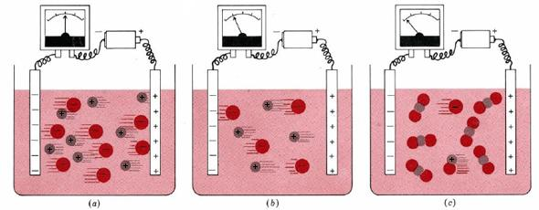
5. Change in concentration measured using conductivity
Ions concentration and their charges determines the solution’s total electrical conductivity
If ions decrease as they react, you would expect to see a reduction of electrical conductivity
Use inert electrodes in the solution to measure electrical conductivity

Slide 12
6. Clock Reactions
Reactions that have an arbitrary ‘end point’ to stop the reaction
Can only be used to give and average rate over the whole interval
Examples:
Dissolving Mg ribbon in HCl is can be measured by the length of time until the ribbon is no longer visible
Sodium thiosulfate reacting with HCl can be measured by the formation of sulfur precipitating from solution

Slide 13
https://youtu.be/0Bt6RPP2ANI

Slide 14
Collision theory: Kinetic energy and temperature
Kinetic-molecular theory of matter – DO NOT COPY THIS!!
All matter is made of tiny particles called atoms, or atoms that are joined to form molecules
These particles are in constant motion
Molecular motion is random
Particles in motion possess kinetic energy
Their motion increase as they gain energy
There is transfer of energy between particles during collision between them
Particles in gases do not exert large forces on each other, unless they are in collision with each other
Collisions between these particles are perfectly elastic
Molecular motion is greatest in gases, less in liquids, and least in solids
Solids retain a fixed volume and shape – particles are tightly packed, usually in a regular pattern
Liquids assume the shape of the container which it occupies but maintain their volume – particles close together with no regular arrangement
Gases assumes the shape and volume of its container and will expand to fill a container of any size – particles are very well far apart with no regular arrangement

Slide 15
Collision theory: Kinetic energy and temperature
The average kinetic energy of molecules in a substance is related to temperature and therefore, related to Absolute temperature (measured in Kelvin)

Slide 16
Collision theory: Maxwell-Blotzmann Distribution Curve

Slide 17
Collision theory: How RXNs Happen
When particles collide, they may break bonds or form bonds
The rate of RXN depends on how many of the collisions result in the formation of desired product
Not all collisions are ‘successful’
Depends on : 1. Energy of collision and 2. Geometry of collision
Depends on Energy of collision
Need to hit at least activation energy threshold to achieve transition state
Only particles that have enough KE will be successful even though particles with lower KE will still collide (not successful collisions)

Slide 18
Collision theory: How RXNs Happen
Depends on Geometry of collision

Slide 19
Collision theory: How RXNs Happen
Rate of reaction depends on the frequency of collisions which occur between particles possessing:
1. Values of KE greater than the activation energy
AND
2. Appropriate collision geometry
Watch here!
http://media.pearsoncmg.com/intl/ema/9781447959762_ChemHL_Brown_Ford/animations/Chapter6p287/index.html

Slide 20
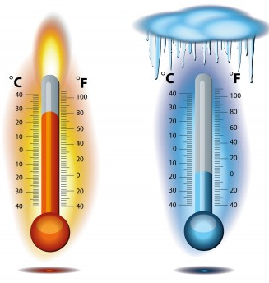
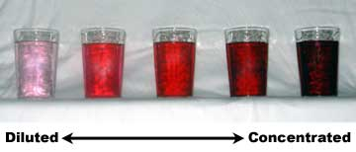
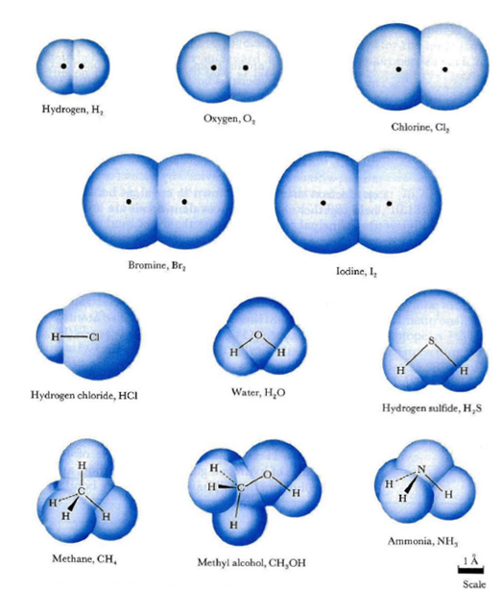
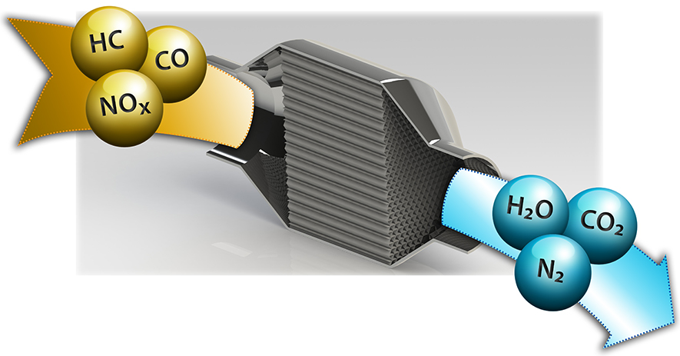
5 Factors affecting rate of reaction “How fast”
Temperature
Concentration
Particle size
Pressure
Catalyst

Slide 21
1. Temperature
Increase temp, increase average KE of particles AND frequency of successful collisions
Thus, increase temp means increase of RXN rate
Area under curve represents all particles in sample

Slide 22
2. Concentration
Increase in concentration of reactants increases rate of RXN
More reactants, more frequent successful collisions

Slide 23
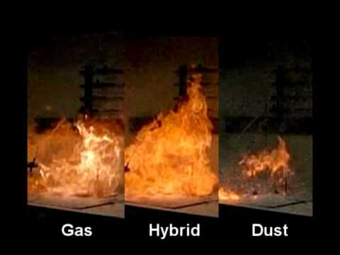
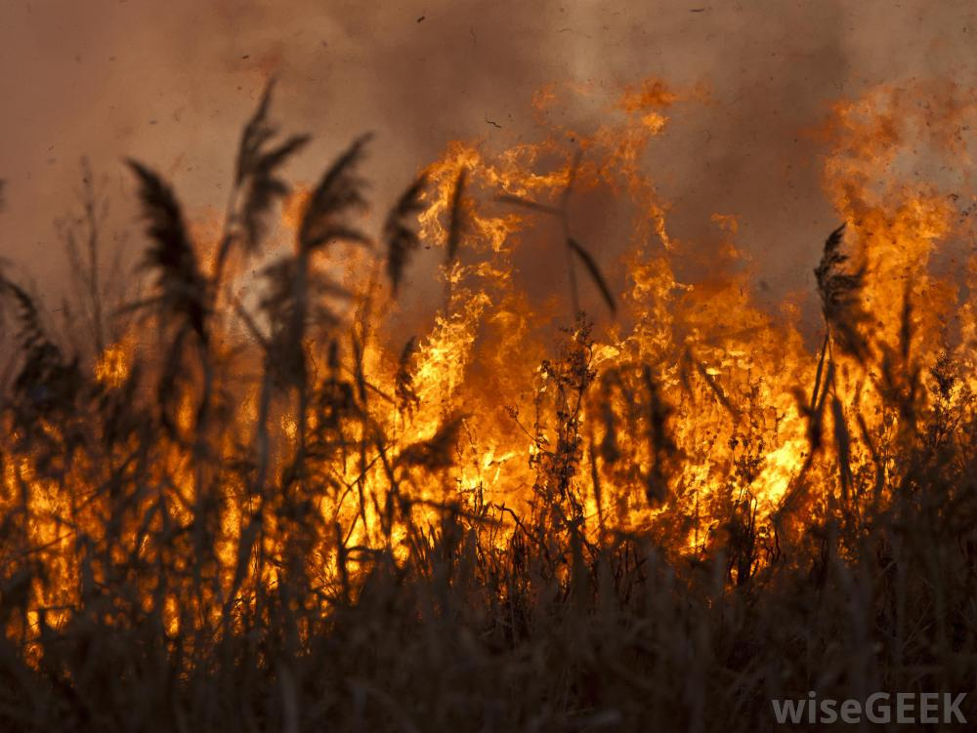
3. Particle size
Decrease particle size, increases rate of reaction
Frequency of successful collisions increases
Heterogeneous reactants, can be affected this way:
More surface area, increases rate of reaction as more successful collisions can occur

Slide 24
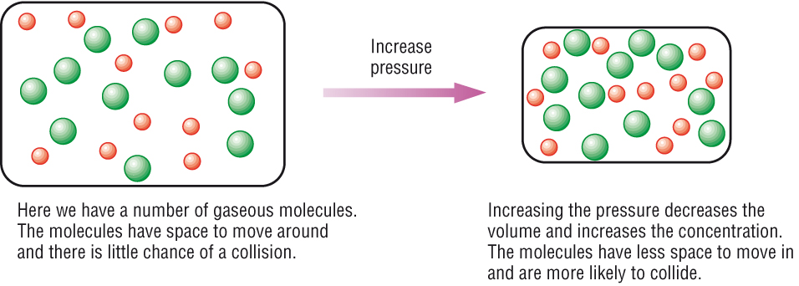
4. Pressure
For gas reactions, increasing pressure increases rate of RXN
Compresses gas to increase concentration and therefore successful collisions

Slide 25
4. Pressure
For gas reactions, increasing pressure increases rate of RXN
Compresses gas to increase concentration and therefore successful collisions

Slide 26
5. Catalyst
Changes the rate of reaction without actually changing itself permanently
So more particles will now have enough KE to react successfully without increasing their KE
Like lowering a hurdle!

Slide 27
5. Catalyst
Maxwell-Boltzmann curve shows how more particles can react
Since the activation energy is changed, it also does not affect the equilibrium position
Super important in industrial RXNs
Biological catalyst: enzyme
Important in Green Chem

