Slide 1
Chapter 16.2: Activation Energy
The activation energy of a reaction can be determined from the effect of temperature on reaction rate.

Slide 2
Important terms for this section
Arrhenius equation
Frequency
Orientation
Constant

Slide 3
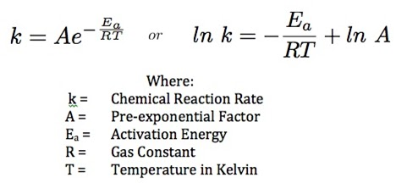
Arrhenius equation
Consider a rate equation, rate = k[A][B]
As the temperature increases, the rate constant increases exponentially
The Arrhenius equation is used to model how the rate constant changes with temperature
k = Ae^{-Ea/RT}

Slide 4
Arrhenius equation
This is the fraction of collisions that have enough E to overcome E_{A}
A contains a factor to address that not all collisions will be in the right orientation
Called the frequency factor or pre-exponential factor
Takes into account frequency of collisions AND the orientation of collisions
Can be considered constant

Slide 5
How to find E_{A} using Arrhenius equation
Conduct a series of experiments at a range of temperatures
Calculate a rate constant, k, for each temperature
Plot a graph of ln k (y-axis) against 1/T (X-axis)
T is the absolute temperature (Kelvin)
This graph should be a straight line
The gradient on the graph is –E_{A}/R, where R is the gas constant
The intercept of the graph on the ln k axis (y-axis) is ln A

Slide 7
How to find E_{A} using Arrhenius equation
In general, if all other things are equal
The higher the E_{A}, the slower it goes
If 1/(e^{Ea/RT})
Then if E_{A} is larger
Then e is larger
AND 1/e is smaller so k is smaller
The value of A will be smaller for more complex molecules
More specific collisions have to occur
A catalyst makes E_{A} smaller and thus, k bigger

