Slide 1
Chapter 16.1: Rate Expression and RXN Mechanism
Rate expressions can only be determined empirically (experimentally) and these limit possible reaction mechanisms. In particular cases, such as a linear chain of elementary reactions, no equilibria, and only one significant activation barrier, the rate of reaction is equivalent to the slowest step of the reaction.

Slide 2
Important terms for this section
Rate constant
Rate expression
Rate law
First-order, second-order, etc
Orders
Overall order
Reaction mechanism
Termolecular
Rate-determining step
Elementary steps
Molecularity
Unimolecular
Bimolecular

Slide 3
Rate-Law for a RXN derived from experimental data
Rate equation or rate expression
If A → B then rate = k[A] and k is the rate constant
Rate of reaction is directly proportional to the concentration of the reactant, A
The rate equation is DETERMINED EXPERIMENTALLY
Relates rate of RXN to the concentrations of substances in the RXN mixture
If W + X → Y + Z then, rate = k[W]^{m}[X]^{n}
The rate constant, k, is a constant proportionality relating the concentrations in the experimentally determined rate equation to the rate of the chemical RXN

Slide 4
Order of a Reaction
In regards to a specific reactant, the order of a reaction is the power of the reactant’s concentration in the experimentally determined rate equation
If A → B and rate = k[A] then the power of [A] is 1, or first-order overall
If Ex: W + X → Y + Z and rate = k[W]^{m}[X]^{n}
Then the overall order is m + n
The rate equation has no connection to the stoichiometric balanced equation!

Slide 5
Steps to find out rate equation
For A + B → C
To find the rate equation, do the following experiments:
Hold [B] constant and change the concentration of A
Create graph of [A] vs time to find initial rate
Determine order of reaction with respect to (WRT) [A]
Hold [A] constant and change concentrations of [B]
Create graph of [B] vs time to find initial rate
Determine order of reaction WRT [B]
Determine rate equation and then rate constant!

Slide 6
How do we do this? (example)
For 2A → B
Experimental data
We can determine the following:
The order WRT [A]
The rate equation
The value of the rate constant, k (with units)
The rate of the reaction when [A] = 1.3 mol dm⁻³
Experiment number | [A] (mol dm⁻³) | Rate (mol dm⁻³ s⁻¹)
1 | 1.0 | 0.60
2 | 2.0 | 1.2
3 | 5.0 | 3.0

Slide 7
1. The order WRT [A]
For 2A → B
Experimental data
The rate of reaction has doubled when [A] doubles, so this means the POWER of the reaction rate is 2¹ so the order is first!
The reaction doubles so it’s 2 to the FIRST power!
Experiment number | [A] (mol dm⁻³) | Rate (mol dm⁻³ s⁻¹)
1 | 1.0 | 0.60
2 | 2.0 | 1.2
3 | 5.0 | 3.0

Slide 8
2. The rate equation
For 2A → B
Experimental data
The reaction is 1st order WRT A so:
Rate = k[A]
Experiment number | [A] (mol dm⁻³) | Rate (mol dm⁻³ s⁻¹)
1 | 1.0 | 0.60
2 | 2.0 | 1.2
3 | 5.0 | 3.0

Slide 9
3. The value of the rate constant, k (with units)
For 2A → B
Experimental data
We can plug in values into the rate equation to solve for k
Rate = k[A]
0.60 mol dm⁻³ s⁻¹ = k * 1.0 mol dm⁻³
Thus, k = 0.60 s⁻¹
Experiment number | [A] (mol dm⁻³) | Rate (mol dm⁻³ s⁻¹)
1 | 1.0 | 0.60
2 | 2.0 | 1.2
3 | 5.0 | 3.0

Slide 10
4. The rate of the reaction when [A] = 1.3 mol dm⁻³
For 2A → B
Experimental data
Rate = 0.60 s⁻¹ x 1.3 mol dm⁻³
Rate = 0.78 mol dm⁻³ s⁻¹
Experiment number | [A] (mol dm⁻³) | Rate (mol dm⁻³ s⁻¹)
1 | 1.0 | 0.60
2 | 2.0 | 1.2
3 | 5.0 | 3.0

Slide 11
Problem 1
Given the date for A + B → C + D
Determine:
The order WRT A
The order WRT B
Overall order of the reaction
The rate equation
Value of the rate constant (with units)
Rate of the reaction when [A] = 1.60 mol dm⁻³ and [B] = 0.30 mol dm⁻³
Experiment | [A] (mol dm⁻³) | [B] (mol dm⁻³) | Rate(mol dm⁻³ h⁻¹)
1 | 0.10 | 0.10 | 0.50
2 | 0.30 | 0.10 | 4.50
3 | 0.30 | 0.20 | 4.50

Slide 12
Problem 1: a) the order WRT A
Given the date for A + B → C + D
Looking at experiment 1 → 2, the [A] 0.10 → 0.30 = 3X
The rate changes 0.50 → 4.50 = 9X
So the factor concentration is = 3²
The order WRT A is 2 (second-order)
Experiment | [A] (mol dm⁻³) | [B] (mol dm⁻³) | Rate(mol dm⁻³ h⁻¹)
1 | 0.10 | 0.10 | 0.50
2 | 0.30 | 0.10 | 4.50
3 | 0.30 | 0.20 | 4.50

Slide 13
Problem 1: b) the order WRT B
Given the date for A + B → C + D
Looking at [B] for experiment 2 → 3, 0.10 → 0.20 = 2X
The rate does not change 4.50 → 4.50 = 0X
So the factor concentration is 2⁰
The rate order WRT B is 0 (zero-order)
Experiment | [A] (mol dm⁻³) | [B] (mol dm⁻³) | Rate(mol dm⁻³ h⁻¹)
1 | 0.10 | 0.10 | 0.50
2 | 0.30 | 0.10 | 4.50
3 | 0.30 | 0.20 | 4.50

Slide 14
Problem 1: c) overall order of the reaction
Given the date for A + B → C + D
The overall rate of reaction:
[A]²[B]⁰ = 2 + 0 = 2
Experiment | [A] (mol dm⁻³) | [B] (mol dm⁻³) | Rate(mol dm⁻³ h⁻¹)
1 | 0.10 | 0.10 | 0.50
2 | 0.30 | 0.10 | 4.50
3 | 0.30 | 0.20 | 4.50

Slide 15
Problem 1: d) the rate equation
Given the date for A + B → C + D
The rate equation is:
Rate = k[A]²[B]⁰
Or just written: rate = k[A]²
Experiment | [A] (mol dm⁻³) | [B] (mol dm⁻³) | Rate(mol dm⁻³ h⁻¹)
1 | 0.10 | 0.10 | 0.50
2 | 0.30 | 0.10 | 4.50
3 | 0.30 | 0.20 | 4.50

Slide 16
Problem 1: e) value of the rate constant (w/ units)
Given the date for A + B → C + D
It doesn’t matter which experiment is used to calculate the rate constant. But let’s use experiment 2
rate = k[A]²
4.50 = k x (0.30²) k = 50 mol⁻¹ dm³ h⁻¹
K = 50
For the units, mol dm⁻³ h⁻¹ = k x (mol dm⁻³)²
h⁻¹ = k x mol dm⁻³ → k = mol⁻¹ dm³ h⁻¹
Experiment | [A] (mol dm⁻³) | [B] (mol dm⁻³) | Rate(mol dm⁻³ h⁻¹)
1 | 0.10 | 0.10 | 0.50
2 | 0.30 | 0.10 | 4.50
3 | 0.30 | 0.20 | 4.50

Slide 17
Problem 1: f) rate of RXN given [A] and [B]
Given the date for A + B → C + D
What is the rate if [A] = 1.60 mol dm⁻³ and [B] = 0.30 mol dm⁻³
Rate = k[A]²
Rate = 50 x 1.60²
Rate = 128 mol dm⁻³ h⁻¹
Experiment | [A] (mol dm⁻³) | [B] (mol dm⁻³) | Rate(mol dm⁻³ h⁻¹)
1 | 0.10 | 0.10 | 0.50
2 | 0.30 | 0.10 | 4.50
3 | 0.30 | 0.20 | 4.50

Slide 18
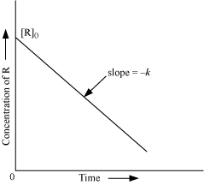
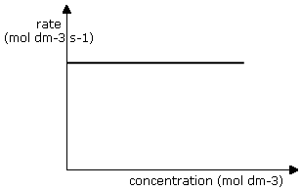
More about orders of reaction: Zero-order
Zero-order reactions: rate depends on NO concentration
When changing the concentration for a RXN does not affect the rate
The rate equation is then rate = k
The units for k are mol dm⁻³ s⁻¹ (or other time measurements)

Slide 19
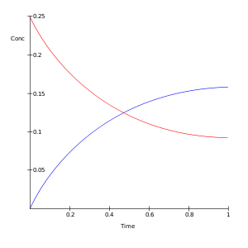
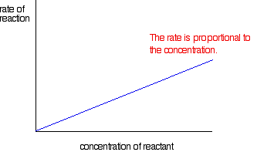
More about orders of reaction: First-order
First-order reactions: depends on 1 concentration
The rate is directly proportional to the concentration
Half-life of a RXN: time for concentration to drop by half
For first-order, the half-life does not depend on concentration
It’s gonna half at a constant rate!
Same amt of time to 1.0 → 0.50 as from 0.80 → 0.40
Red is reactant
Blue is product

Slide 20
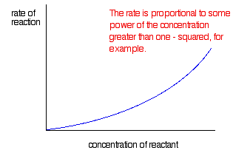
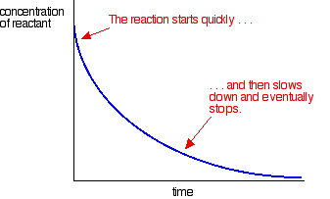
More about orders of reaction: Second-order
Second-order reactions: depends on 1 or more concentrations
The rate of reaction is proportional to concentration squared
OR
Two first-order reactants in the RXN
These RXNs do not have a constant half-life

Slide 21
More about orders of reaction

Slide 22
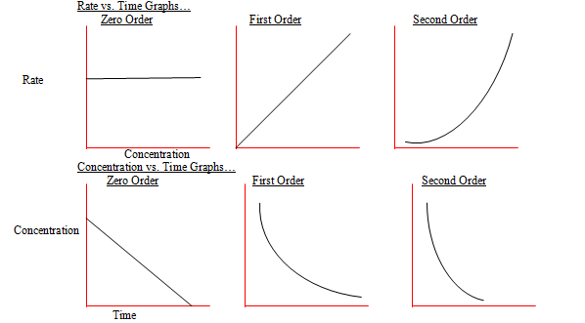
More about orders of reaction

Slide 23
Units of rate constants
Generally: concentration^{(1-overall order)} time⁻¹
Overall order | Units of k | Example of units
0 | Concentration time⁻¹ | Mol dm⁻³ s⁻¹
1 | Time⁻¹ | s⁻¹
2 | Concentration⁻¹ time⁻¹ | Mol⁻¹ dm³ s⁻¹
3 | Concentration⁻² time⁻¹ | Mol⁻² dm⁶ s⁻¹

Slide 24
Mechanisms of RXN
Why can’t the rate equation be derived from the chemical equation?
Short answer: because RXNs can happen in steps (mechanisms), not just in 1
For example, 2NO₂(g) + F₂(g) → 2NO₂F(g)
There are 3 molecules that need to collide to produce the product
If there was 1 step for them all to collide, the rate = k[NO₂]²[F₂]
BUT… the actual rate = k[NO₂][F₂]
This suggests that there is more than 1 step
Makes sense since the chances that all 3 colliding exactly right is small
The mechanism is as follows:
NO₂ + F₂ → NO₂F + F
NO₂ + F → NO₂F
Overall the reaction works out to 2NO₂(g) + F₂(g) → 2NO₂F(g)

Slide 25
Mechanisms of RXN
The mechanism must be consistent with the overall chemical equation
The slowest step in the mechanism is the rate-determining step
NO₂ + F₂ → NO₂F + F rate = k₁[NO₂][F₂] slow
NO₂ + F → NO₂F rate = k₂[NO₂][F] fast
Since the second step is so fast, there is no influence
on the overall rate
Thus, changing their concentrations makes no difference
to the overall rate
The formation of the intermediate is also shown between
the transition states

Slide 26
Mechanisms of RXN
Let’s look at another example
B + B → Q rate-determining step
Q + A → C fast
Overall reaction: A + 2B → C
So what is the rate equation?
Since A is not involved in the rate determining step, the rate = k[B]²
Consider if the second equation is the rate-determining step:
B + B ↔ Q fast
Q + A → C rate-determining step
So the rate of the second step is, rate = k[Q][A]
But the first has to also be taken into consideration, since [Q] is dependent on [B]
[Q] = [B]²
Thus, rate = k[B]²[A] The real rate equation would be determined experimentally!!

Slide 27
Mechanisms of RXN: Catalysts
Catalysts change the reaction mechanism → alternative pathway w/ lower E_{A}
Example: CH₃COCH₃(aq) + I₂(aq) → CH₃COCH₂I(aq) + HI(aq)
Catalyzed with acid H⁺
Rate = k[CH₃COCH₃][H⁺]
Note the rate does not include [I₂] (so must be involved after rate-determining step)
CH₃COCH₃ + H⁺ → X rate-determining step
X + I₂ → CH₃COCH₂I + HI + H⁺ fast
The catalyst is used in the rate-determining step, but is regenerated at the end
Does not appear in overall reaction!

Slide 28
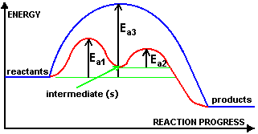
Mechanisms of RXN: Catalysts
Example: A → X + Y (single step)
If you introduce a catalyst:
A + C → A-C (complex) rate-determining step (E_{A1})
A-C → X + Y + C fast (E_{A2})
The rate equation for the original equation is rate = k[A]
The rate equation for the catalyzed reaction is rate = k[A][C]

Slide 29
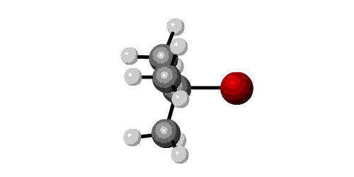
Mechanisms of RXN: S_{N}1 vs S_{N}2 mechanisms
S_{N}1 involves the substitution of a nucleophile onto a tertiary halogenoalkane
Unimolecular means the rate-determining step involves only 1 molecule
(CH₃)₃CBr + OH⁻ → (CH₃)₃COH + Br ⁻
Experimentally determined: Rate = k[(CH₃)₃CBr]
OH⁻ is only in the fast step after the rate-determining step since it is not in the rate equation
(CH₃)₃CBr → (CH₃)₃C⁺ + Br ⁻ rate-determining step
(CH₃)₃C⁺ + OH⁻ → (CH₃)₃COH fast step

Slide 30
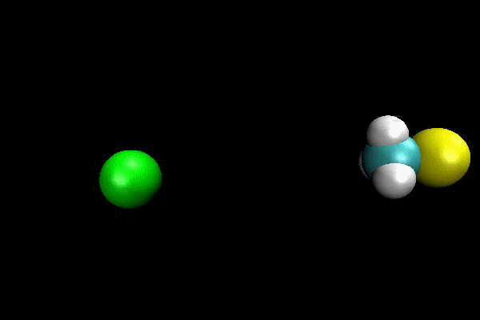
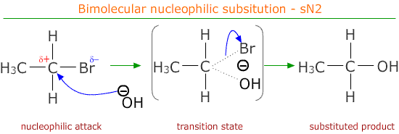
Mechanisms of RXN: S_{N}1 vs S_{N}2 mechanisms
S_{N}2 involves the substitution of a nucleophile onto a primary halogenoalkanes
Bimolecular means the rate-determining step involves 2 molecules
CH₃CH₂CH₂Br + OH⁻ → CH₃CH₂CH₂OH + Br ⁻
Experimentally determined: Rate = k[CH₃CH₂CH₂Br][OH⁻]
They both appear once in the rate equation, suggesting a single step
CH₃CH₂CH₂Br + OH⁻ → CH₃CH₂CH₂OH + Br ⁻ rate-determining step

Slide 31
Mechanisms of RXN: Rules for writing mechanisms
The mechanism must agree with the overall stoichiometric equation
A maximum of 2 particles can react in any one step
All species in the rate equation must appear in the mechanism in or before the rate-determining step
The power of a particular reactant’s concentration in the rate equation indicates the number of times it appears in the mechanism up to and including the rate-determining step

