Slide 1
Chapter 15.9: Drug detection and analysis Chapter 15.6: Environmental impact of some medications
D.9: A variety of analytical techniques is used for detection, identification, isolation and analysis of medicines and drugs.
D6: The synthesis, isolation, and administration of medicines can have an effect on the environment.

Slide 2
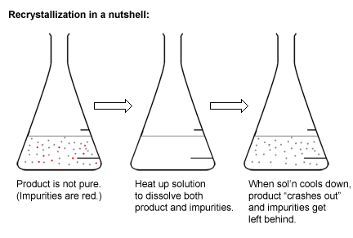
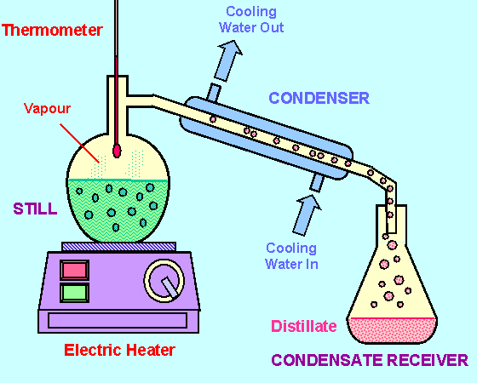
Drug isolation and purification
Isolation of drugs in pure form is important!
When synthesis is completed, how do we purify the drug?
By using and exploiting the different physical properties!
Differences in solubilities in different solvents
Like we saw with aspirin
Differences in volatility
Like we saw with aldehydes from primary alcohols

Slide 3
Organic structure and solubility
Solubility of a compound: like dissolves like
But more specifically, the intermolecular forces
Between molecules of the solvent and solute particularly
Aspirin is modified to be more aqueous so it more soluble
Fluoxetine (Prozac) is also modified
Extraction: choosing a solvent to selectively dissolve a particular component
Solvent extraction: using the solubility of a compound into a particular solvent and an immiscible one

Slide 4
Solvent extraction
A compound, X, is synthesized in an aqueous solution
It is known that X has greater solubility in non-polar solvents such as hexane
Hexane is less dense than water, so when poured together, hexane is the top layer
Shaking the mixture vigorously in a separation funnel will allow X to move into the hexane layer
Allowing the layers to separate and pouring out the bottom layer keeps the X and hexane layer
Evaporate the hexane to retain X
Separation
Then recrystallization

Slide 5
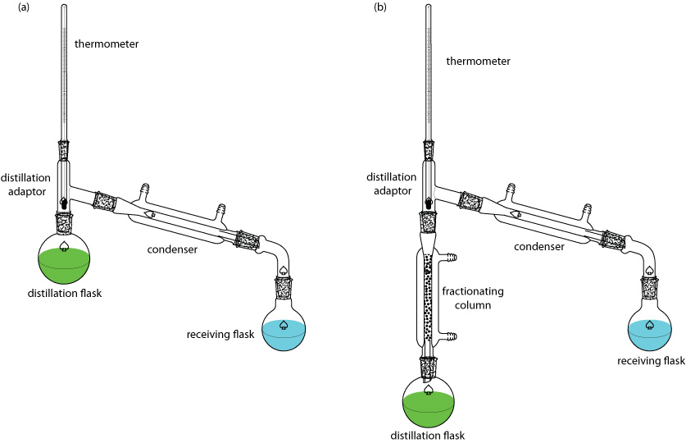
Organic structure and volatility
IMFs also affect boiling point of a compound
Molecular size: larger molecules = more LDFs and higher boiling point
Polarity: more polar functional groups lower boiling point (H-bonds)
Amide > carboxyl > hydroxyl > ketone > aldehyde > amino > ester > ether
Fractional distillation
Separation of the mixture of liquids within a narrow boiling point range into fractions
We will be saving the
fractional distillation
equations and Raoult’s Law
for next year when you
work on chapters 6-7

Slide 6
Drug detection: steroids
Steroids: lipids with 4 fused rings (steroidal backbone)
Section 34 in Data Booklet
Cholesterol and sex hormones are commonly tested for steroids
Anabolic steroids (testosterone analogues)
Use of GC-MS (gas chromatography-mass spectrometry)
GC separates mixture into pure substances
MS identifies and quantifies components of mixture
GC: https://youtu.be/4Xaa9WdXVTM
MS: https://youtu.be/mBT73Pesiog
GC-MS: https://youtu.be/T4_eF9idFS4
Fundamentals of GC: https://youtu.be/piGSGkcwFAw

Slide 7
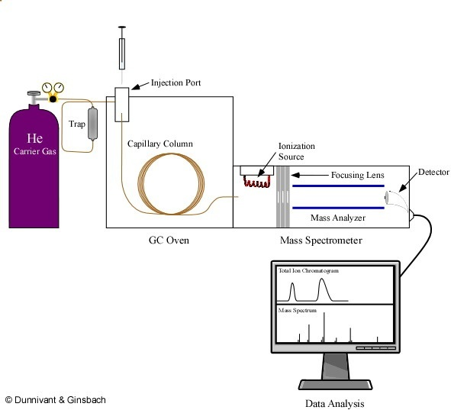
GC-MS overview

Slide 8
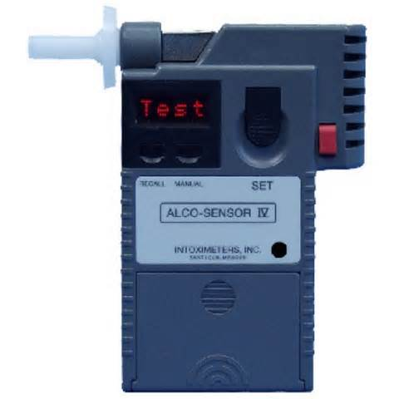
Drug detection: ethanol
Roadside breathalyzers use K₂Cr₂O₇ crystals to determine the concentration of ethanol in the breath
The degree of change is determined by a photocell which can estimate the concentration (usu. used as a preliminary test)
Intoximeters are then used
Alcosensor uses a fuel cell to determine ethanol concentration
Fuel cells are discussed in chapter 9 (redox reactions)

Slide 9
Organic structure analysis & identification
Mass spectroscopy
Used to confirm the presence of a compound
Secondary peaks (other fragments) help to confirm compound structure
Impurities will appear as their specific peaks as well
Infrared spectroscopy
Functional groups show up as characteristic absorption peaks
Environment of the bond can influence other peaks
Can be used as a fingerprint of a particular compound
Proton NMR
Chemical shifts and number/height of peaks can help determine identify of compounds
Splitting pattern can help too
Impurities will show up as their own distinctive peaks

Slide 10
Mass spectroscopy

Slide 11
Infrared spectroscopy
Most spectra are compared to known compounds from a database
Salicylic acid Aspirin

Slide 12
Proton NMR

Slide 13
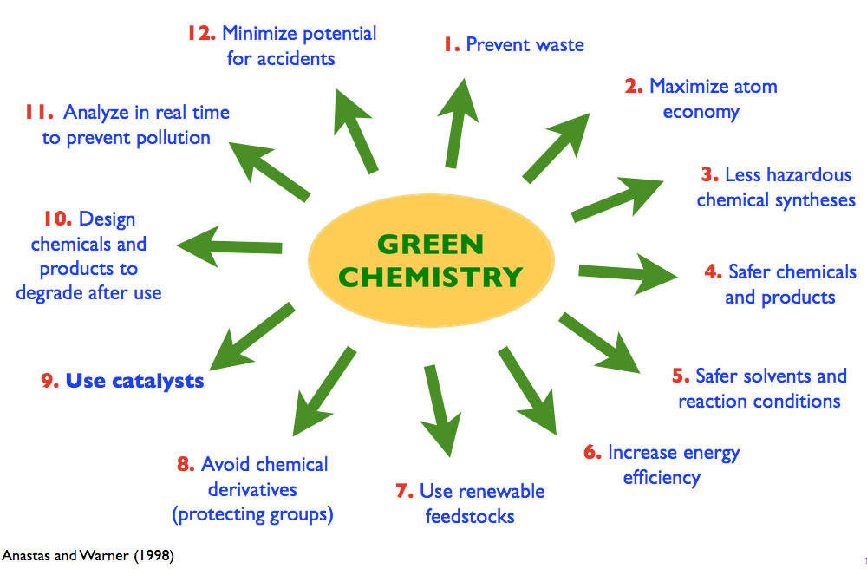
D.6: Environmental impact of some meds
Sustainable chemistry developed since 1991
12 principles (you do not need to learn these)
Address avoiding waste, maximizing production, and use of safe solvents
Reduce footprint and improve product and environmental safety

Slide 14
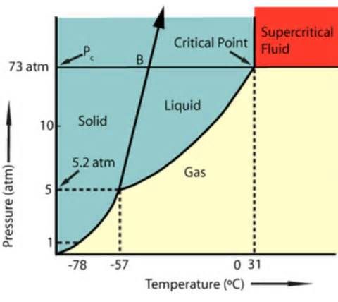
Solvent waste
Reactants left over from synthesis of a drug ~80% due to solvents/water
Solvent waste is the biggest contributor to emission of toxins into environment
Suitability of solvents is assessed by 3 factors:
Toxicity to workers: carcinogenic or other health issues
Safety of processing: flammable or toxic by-products
Harm to environment: contamination of water/soil, ozone depletion, release greenhouse gases when burned
Recycling solvents greatly reduces costs and emissions
Use of H₂O or
supercritical CO₂
whenever possible

Slide 15
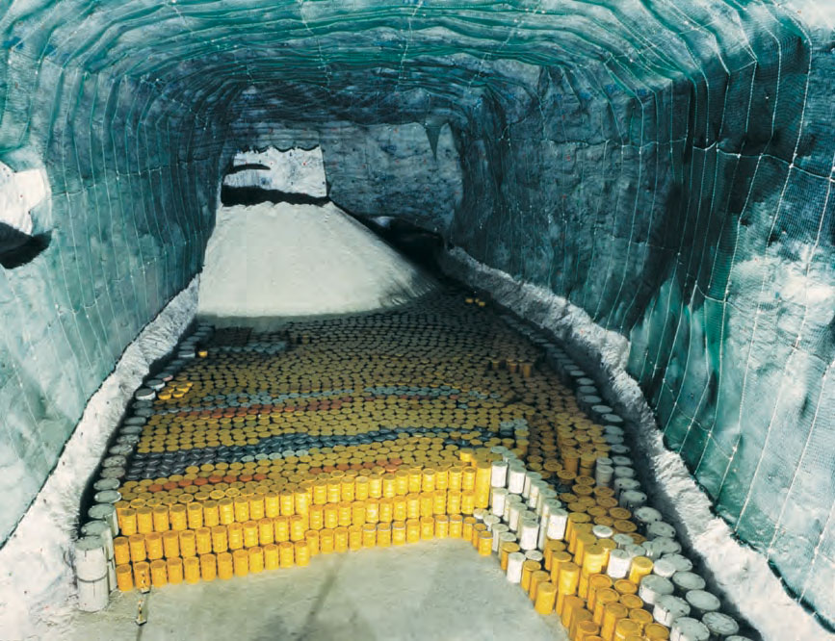
Nuclear waste
More nuclear waste with growing nuclear technology
Two types of nuclear waste
Low-level waste: releases small amounts of ionizing radiation for a short time
Most medical nuclear waste is low-level
Clothing/shoe covers
Paper towels
Contaminated implements
Sealed in containers until safe, then disposed of normally
High-level waste: releases large amounts of ionizing radiation for a long time
Disposal problem = heat and radiation
Store in water 5-10 yrs before transfer to dry, shielded deeply buried structures
Green chemistry
Extract Uranium from incinerator ash
Use florescent dyes instead of radionuclides in diagnosis

Slide 16
Antibiotic waste
Overuse of antibiotics (especially broad-spectrum) has developed so-called superbugs
Can have resistance to multiple antibiotics
Methicillin-resistant Staphylococcus aureus (MRSA) is especially dangerous
Can occur in wound infections, pneumonia, blood poisoning
Mass production of antibiotics and release into environment is major cause of antibiotic resistance
Aquaculture and household pets
Growth promotion and prophylactic use in livestock
Especially bad as it can pass through animal and contaminate soil and water
Pest control in agriculture
Sanitizers in toiletries and cleaning products
Sterilization and culture selection in research and industry
Improper disposal of drugs

Slide 17
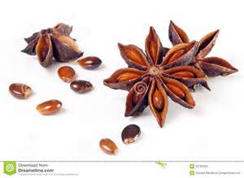
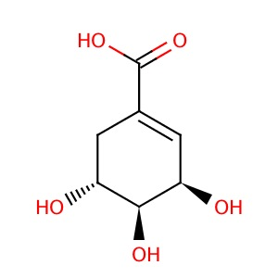
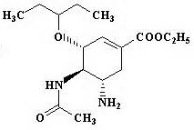
Obtaining the Tamiflu precursor: Green chemistry case study
Precursor of Tamiflu is shikimic acid or its salt shikimate
Most prevalent in Chinese star anise
Low yields are a problem esp. in 2005, so gov’ts stockpile it
Alternate sources are being sought
Fermentation of genetically engineered bacteria
Harvesting low yield precursor from pine needles
Extraction from suspension cultures of Indian sweetgum tree
Inexpensive, natural, no genetic engineering

Slide 18
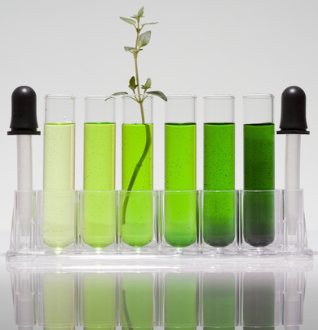
Green Chemistry examples
Viagra
Uses modified reaction route = reduces by 75% amount of waste
Reduces solvent waste
Avoids use of toxic and hazardous reagents
Ibuprofen
Reduced steps in process from 6 → 3
Increased atom economy from 40-77%
Uses more of the material in final product
Decreased energy demand
Lyrica (Analgesic drug)
Uses a natural reagent of an enzyme
Water as solvent
Eliminated emissions of more than 3 million tons of CO₂ compared with original process
Cradle to grave

