Slide 1
Chapter 15.7: Taxol: a chiral auxiliary case study Chapter 15.8: Nuclear medicine
D.7: Chiral auxiliaries allow the production of individual enantiomers of chiral molecules.
D.8:Nuclear radiation, whilst dangerous owing its ability to damage cells and cause mutations, can also be used to both diagnose and cure diseases.

Slide 2
Taxol: chiral auxiliary drug
In vivo = reactions occurring within cells
Typically, biological molecules are only once enantiomer
In vitro = reactions synthesized in a lab
Lab molecules are formed as a racemate
The synthesis of molecules presents an issue
What are the effects of the different isomers?
Will a racemic mixture be effective or only one enantiomer?

Slide 3
Taxol: chiral auxiliary drug
This research took focus based on thalidomide tragedy
The two forms are known to interconvert in the body
Even use of R enantiomer may still produce deformities in fetus
Some racemate drugs include ibuprofen and fluoxetine
Ibuprofen also interconverts in the body
No legal mandate to develop drugs only as a single enantiomer
But ~50% of drugs on market are a single enantiomer

Slide 4
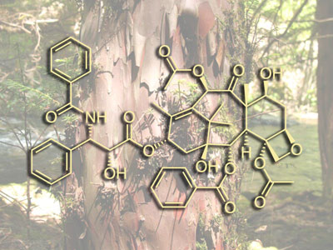
Taxol: chiral auxiliary drug
Taxol
A single enantiomer drug against cancer
Also called Paclitaxel, a taxoid (class of compounds)
Lead compound discovered from yew trees
Compound in bark → kills trees when harvest bark
~200 yrs for yew trees to mature
Synthesis of compound and analogues was critical research
Used primarily against breast and ovarian cancers
Mode of action
Binds to tubulin in cells
Tubulin is used to make microtubules → spindles → cell division
Prevention of the cell division process results in stopping growth of tumor

Slide 5
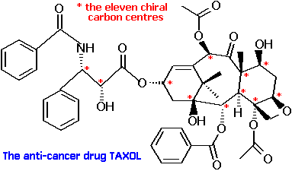
Taxol: chiral auxiliary drug
How is the drug synthesized for only a single enantiomer?
There are 11 chiral carbon centers in taxol
Asymmetric synthesis or enantioselective synthesis
Can use chiral auxiliary process
Chiral molecule that blocks one reaction site through steric hindrance forcing only one side to react
This molecule will hold the product through successive reactions
When reactions complete, auxiliary molecule is released and recycled
Using simple molecules to make taxol is impractical >30 steps

Slide 6
Taxol: chiral auxiliary drug
The solution? Semi-synthetic production
Make Taxol through a precursor: 10-DAB = 10-deacetylbacctin III
Harvested through yew tree needles = more sustainable
Still has 13 steps in synthesis
Uses lots of organic solvents and reactants
Low product yield
New promising option
Some fungi produce Taxol in fermentation
Some plant cultures can be used to create Taxol and then extracted
Use of a polarimeter will tell if the one enantiomer is produced

Slide 7
D.8: Nuclear medicine
Reactivity is often associated with electrons so the nucleus is stable
In nuclear chemistry, the nucleus is unstable and the main reactive part = unstable
Nucleon = nuclear particle
Different types and number depending on the radionuclide
Stable nuclei have balanced forces among nucleons = unreactive
Unstable nuclei have unbalanced forces and therefore excess internal energy
They spontaneously decay to form more stable nuclei = radioactivity
Called radionuclides
Radioactivity emits energy and particles = radiation

Slide 8
Radionuclides
Natural: occurs in nature and have a naturally occurring, stable isotope
Carbon-14
Potassium-40
Uranium-235
Tritium, ³H
Any atom above Po is naturally radioactive with no stable isotope
Induced/artificial: created in a lab to be radioactive
Bombarded with neutrons or helium at high speed
Medically used radionuclides are produced this way
Neutrons and protons are made of quarks
Changes in types of quarks can result in some types of radiation
There are also antiparticles (same mass, but opposite charge)
Positron is antiparticle for electron
Collision of positron and electron = gamma radiation

Slide 9
Radionuclides
When radionuclides decay, the following could happen in nucleus:
Ejection of a neutron
Ejection of a proton
Beta particle formed: e- removed and neutron converts to proton
Proton converts to neutron by loss of positron
Release of gamma rays
New nuclide may be radioactive or stable
Decay can result in new element

Slide 10
Types of radiation
Alpha
Results when eject a particle from nucleus =
Beta
Results when eject an electron from nucleus =
Created when neutron → proton
So increase in atomic number
Mass number stays same
Gamma
Emission of E along with alpha and beta
Does not change atomic mass or number

Slide 11
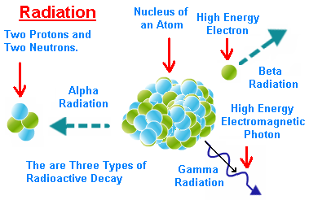
Ionizing effect of radioactive emissions
Radioactive E can cause interaction of atoms by removing e-
Can cause release of non-valence e- = unstable → radicals
Radicals and damaging effects are the reasons radiation can be so dangerous for living organisms
Breaks H-bonds in DNA
Ionization density
Refers to average energy released along unit length of their track
Alpha particles have large mass and high ionization density
X-rays and gamma rays have lower ID (produce radicals more sparsely within a cell)
Alpha will release most E in a small region
Good for controlled therapeutic use
Half-life of isotope
Amount of time for any given amount
of isotope to decay to half

Slide 12
Nuclear medical treatments
Two main therapies
Diagnosis of disease = nuclear imaging
Treatment of disease = radiotherapy
Diagnostic techniques
X-rays can visualize bones, but not soft tissue
Radiopharmaceutical: attach a tracer to a biological molecule
Use a gamma camera to trace inside the body
Radiopharmaceuticals
Target a certain organ or part of body
Iodine – thyroid gland
Glucose – brain
Tracers must have enough E to escape body and enough half-life for scan to complete before decay
Most common is Technetium-99m = 6 hr half-life, artificial
Releases gamma rays, chemically versatile (bonds to many things)

Slide 13
Diagnostic nuclear medical treatments
Positron Emission Topography (PET)
Uses Fluorine-18 bonded to glucose for cancer cell identification
Emits positrons that will combine with e- and emit gamma radiation
Used in conjunction with CT scans
Magnetic Resonance Imaging (MRI)
Application of NMR
Uses radio waves to detect the protons
Good to use as body is ~70% H₂O
Relatively non-invasive since it uses radio waves and not ionizing radiation

Slide 14
Radionuclide Therapy
Cancer is difficult to treat
Cancer cells multiply much faster than normal cells
They are much more susceptible to ionizing radiation (DNA, remember?)
Radiation therapy kills healthy cells, but not to the same extent
Cancer radionuclides
Strong beta-emitters (and gamma for imaging)
Lutetium-177
Yttrium-90
Two types of radionuclide therapy
External radiotherapy or teletherapy
Internal radionuclide therapy

Slide 15
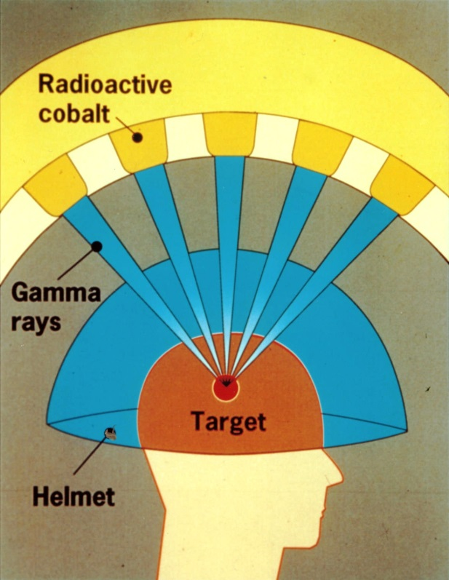
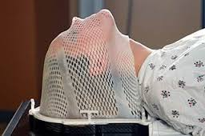
Radionuclide Therapy: External
External source of radioactive radiation is directed at the cancer in body
Cancer cells are susceptible to damage by gamma radiation
Two other kinds of new treatments
Linear accelerator – microwave tech accelerates e- aimed at heavy metal target to aim resultant X-rays at tumor
Gamma knife radiosurgery (see images)

Slide 16
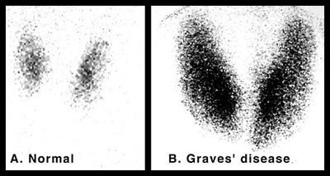
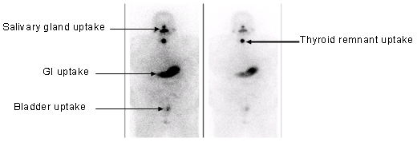
Radionuclide Therapy: Internal
Internal radionuclide therapy: radioactive material is taken into body as liquid, solid, or implant
Implant: placed near tumor site as seed, wire, or tube and left to emit gamma rays for destruction of tumor cells
This may involve isolating patient as emission of gamma may be a danger to others
Common isotopes used
Phosphorus-32 for blood disorders
Strontium-89 for secondary bone cancer, esp. pain control
Iodine-131 for thyroid cancer

Slide 17
Radionuclide Therapy: Internal
Targeted alpha therapy (TAT): radioimmunotherapy
Uses alpha radiated targets attached to antibodies to attach exactly to certain cells (pancreatic, melanoma, ovarian cancers)
Boron neutron capture therapy (BNCT)
Non-radioactive boron is concentrated in malignant brain tumors
Irradiation with neutrons so Boron “captures” neutrons
Emission of alpha particles results in killing cancer cells
Problems: cannot control uptake from healthy cells

Slide 18
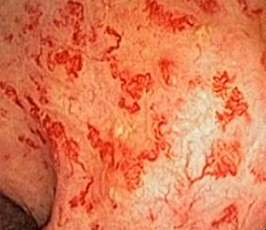
Side-effects of radiotherapy
External tends to cause more side-effects than internal therapy
Much reduced nowadays, but still exists
Hair-loss (rapidly dividing cells)
Fatigue
Nausea
Sterility
Skin reaction (irritated skin, red, sore, itchy)

