Slide 1
Chapter 15 D.4: pH regulation D.5: Antiviral Meds
D.4: Excess stomach acid is a common problem that can be alleviated by compounds that increase the stomach pH by neutralizing or reducing its secretions
D.5: Antiviral medications have recently been developed for some viral infections while others are still being researched

Slide 2
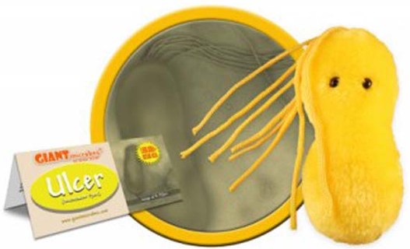
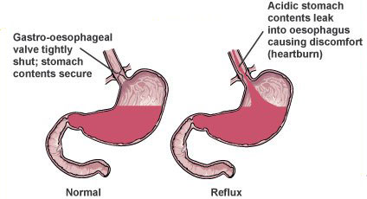
Acidity in the stomach
HCl is the acid produced in the gut/stomach pH = 1-2
Parietal cells in stomach wall release acid = gastric juice
Excess alcohol, smoking, caffeine, stress, some anti-inflammatory drugs can cause increased acid production
Dyspepsia – feelings of pain and discomfort
Acid indigestion: discomfort from too much acid in stomach
Heartburn: acid rising into esophagus (acid reflux)
Ulceration: damage to lining of gut wall

Slide 3
H₂ receptors
1980s bacterium Helicobacter pylori is found to burrow into stomach lining and prevent the stomach from protecting itself from the acid
Thus, antibiotics can be used to treat some stomach issues
In combo with acid reducers
H₂-receptor antagonists
NOT meaning hydrogen!!
These are the receptors in parietal cells
Histamine binds these receptors and causes a release of acid
Drugs target this site and compete with histamine
Zantac = H₂ antagonist

Slide 4
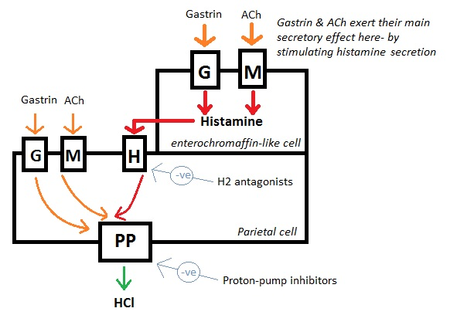
Proton pump inhibitors
In the final step of gastric juice production,

Slide 5
Proton pump inhibitors
In final step of gastric juice production, protons pumped across the membrane into the lumen of stomach
When H+ pumped across, K+ is pumped back
These are pumped against their gradients = takes ATP
Prilosec and Nexium are examples of proton pump inhibitors

Slide 6
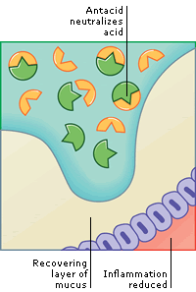
Antacids are weak bases
Antacids neutralize stomach acid
Strong bases would be too caustic for the stomach
Do not heal ulcer or cover it
Reduces acid to allow ulcer to mend “no acid, no ulcer”
Often in forms of metal-
Oxides, carbonates, hydroxides or hydrogencarbonates

Slide 7
Antacids are weak bases
Metal hydroxides neutralize by:
Many have both Al and Mg
Mg salts are faster acting and a laxative
Al salts dissolve slower and are longer lasting and cause constipation

Slide 8
Antacids are weak bases
Metal carbonates and hydrogencarbonates neutralize by:
Gas released may cause bloating and toots!
Antifoaming agents added to the formulas
Some have alginates which float to top of stomach and prevent reflux of the acid
Some drugs should not be taken with antacids due to pH change in the stomach can interfere with absorption

Slide 9
Do not do pH and buffering at this time
OMIT exercise 15

Slide 10
Viruses
Viruses are smaller than bacteria: sub-microscopic
Can only be seen with an electron microscope
Contain 2 main components
Protein coat
Nucleic acid: DNA or RNA
Have no cellular structure
Must reproduce inside a living cell
Take over host functions to reproduce
Uses host’s components to assemble
more viruses and then bursts the cell
to release the newly-made viruses

Slide 11
Viruses
Antibodies are the body’s immune response to viral infection
This often leads to immunity against repeated infection
Sometimes, virus can remain dormant in cells
Herpes
Chicken pox
Viruses can be difficult to combat
Flu, Measles, Polio, Meningitis, AIDS, Ebola, Smallpox
Difficult to combat:
Mutate very quickly
Very little structure for drugs to target
ANTIBIOTICS DO NOT WORK AGAINST VIRUSES!!

Slide 12
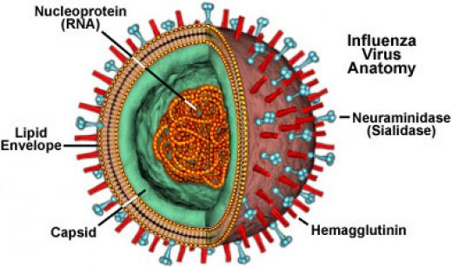
Antiviral Medications
Vaccines created as prophylatic to viral infection
Best defense against getting a virus in the first place as they can be difficult to treat and many have no cure
Common mutation cause trouble for vaccines (i.e. flu)
What can we do against viruses once they have infected a person?
Antiviral medications
Work by interfering with virus life cycle
Alter DNA in cell
Block enzyme activity
Change cell membrane
inhibiting entrance of virus
Best if used as a prophylactic

Slide 13
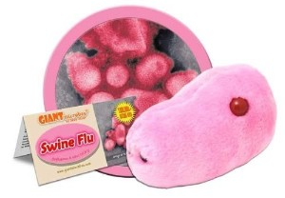
Flu viruses: a case study in antivirals
Influenza kills about 500,000 people each year
Constant fear of a world outbreak = pandemic
Can develop into pneumonia
Flu caused by 2 main types of virus
Influenza A and B
Have specific proteins on surface
Hemagglutinin (H)
Glycoprotein to enable virus to ‘dock’ to host cell
Neuraminidase (N)
Enzyme that cuts off a sialic acid on cell membrane allowing viral particles to escape host cell
Hence the naming of flus such as H1N1 and H5N1

Slide 14
Flu viruses: a case study in antivirals
N seems to be a better target, so most research focuses around this target
Sialic acid is the substrate that binds to the active site of the neuraminidase enzyme
Relenza and Tamiflu inhibit the N enzyme

Slide 16
AIDS: a viral pandemic
AIDS caused by HIV was first diagnosed in 1981
Characterized by virus that causes failure of the immune system
Person then may suffer from cancer, pneumonia, or other life-threatening infections
HIV mainly infects white blood cells = CD4⁺T cells
Binds to receptor proteins and penetrates cell
Retrovirus:
HIV has RNA so reverse transcriptase converts RNA into DNA and incorporates it into host DNA
Virus replicates with cell when it divides
Produces viruses and releases them when cell dies
This is why the host can stay alive for so long before succumbing

Slide 17
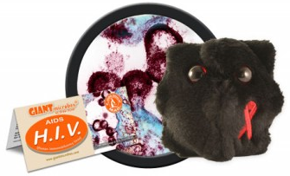
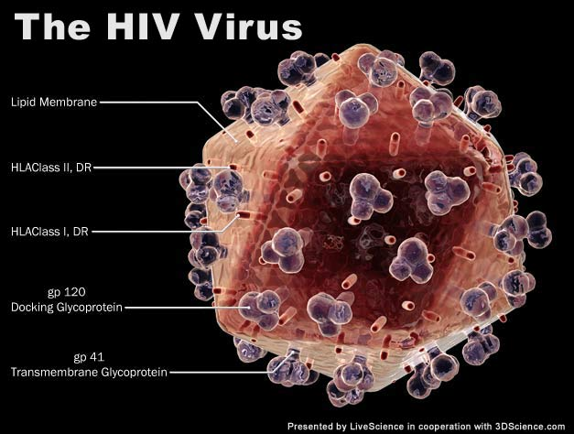
AIDS: a viral pandemic
Challenges in combating HIV
Virus destroys helper T cells = defenders of the body
Mutations occur often = immune response can’t keep up
Virus can lay dormant within host cells = hide from immune response
Antiretrovirals (ARVs)
Can suppress the virus even in pregnancy
Most common ARVs: inhibit reverse transcriptase
Works best in combination
with other reverse transcriptase
inhibitors

