Slide 1
Chapter 15: medicinal chemistry D.1: Pharmaceutical products and drug action D.2: Aspirin and Penicillin
D.1: Medicines and drugs have a variety of different effects on the functioning body
D.2: Natural products with useful medicinal properties can be chemically altered to produce more potent and safe medicines

Slide 2
Important terms in these sections
Medicine
Drug
Therapeutic effect
Bioavailability
Dosage
First-pass effect
Enzyme
Side-effect
Tolerance
Dependence/addiction
Withdrawal symptoms
Dosing regime
Therapeutic Window
Therapeutic index (TI)
Effective dose (ED)
Lethal does (LD)
Toxic dose (TD)
Analogues
Analgesic
Synergy
Antibiotics
Beta-lactam
Transpeptidase
Antibacterial resistance

Slide 3
D1: Intro to medicines and drugs
Drug = chemical affecting how body works for good and worse
Can be illegal dugs as well
Medicine = substance that improves health and therefore a therapeutic effect
Can be natural or synthetic

Slide 4
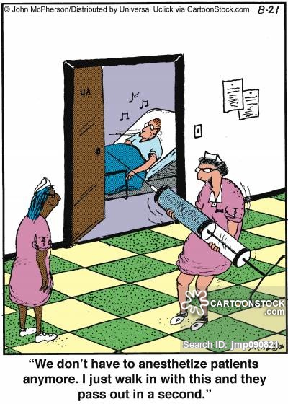
Injection administration of medicine

Slide 5
Bioavailability of drugs
Dosage: how much of a drug to administer
Bioavailability: the fraction of the drug dosage that reaches the bloodstream
Intravenous = 100% bioavailable
First-pass effect in oral drugs
Low bioavailability = 20-40% may reach bloodstream
Digestive system
Enzymes may alter them chemically
Liver may breakdown more of the drug
Solubility of a drug
Aqueous solubility – helps pass through blood
Lipid solubility – helps pass through membranes
Functional groups
Different charges on molecule can change reactivity and solubility

Slide 6
Physiological effects of drugs
Side-effects
Can be beneficial,
benign, or damaging
Tolerance and addiction
Tolerance occurs when the drug’s efficacy is reduced
Addiction occurs when there are withdrawal symptoms if drug is withheld
Dosage
Specific quantity of drug to be taken at one time and how frequently
Difficult due to so many factors: age, sex, weight, diet, interactions with other drugs, etc.
Must maintain in a “window” so as effective, but not too much

Slide 7
Dosage : Therapeutic determinations
Range of concentrations that determine therapeutic window varies by drug
Larger window = higher Therapeutic Index (TI)
TI: ratio of dosage that produces toxicity to the dose that produces a clinically effective response in 50% of the population

Slide 8
Dosage : Therapeutic determinations
Minimum effective dose: ED50
Dose producing therapeutic effect in 50% of population
Lethal dose: LD50
Dose that is lethal to 50% of the population (animal trials)
Toxic dose: TD50
Does that is toxic to 50% of population (human studies)

Slide 9
Dosage : Therapeutic determinations
TI is the measure of drug’s safety

Slide 10
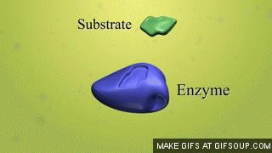
Drug interactions with receptors
Drugs are molecules that bind to a specific receptor in the body
Enzymes, cell membrane cites, DNA, etc.
Usu. Non-covalent bonding: ionic, H-bonds, van der Waals’ forces, hydrophobic interactions (polarity)
Drugs binding to receptors prevents or inhibits normal bio activity
The better the fit, the more effective the drug

Slide 11
Drug design and development
Stringent controls over development and licensing (plus testing, patents, etc.)
10-12 years on average to get to market
Rational drug design
Investigating a specific receptor and creating drugs (or molecular targets) that “fit” for a specific interaction
Less trial and error, Fewer toxic side-effects, More effective

Slide 12
Drug design and development
Once a target molecule is identified, need to find a lead compound (usu. from nature)
Yew trees – cancer → Taxol
Foxglove flower – heart meds → digitalis
Often now found in microorganisms or rainforest plants
Start with the lead compound and synthesize analogues
Identify analogues that can be tested on animals and humans using the TI to determine levels to test

Slide 13
Drug design and development

Slide 14
D2: Aspirin
Aspirin is a mild analgesic
Analgesic: painkiller (treats an underlying problem)
Mild: targets site of pain receptor on body (site of injury)
Strong: targets site of pain perception in brain
Process of pain:
Cells are damaged (thermal, physical, chemical)
Prostaglandins are released from cells and mediate an inflammatory response
Swelling of blood vessels and fever
To stop pain:
Interception of signal before brain
Receptors receive it
NSAIDs: non-steroidal
anti-inflammatory drugs

Slide 15
Development of Aspirin
Willow (salix) bark – pain relief → aspirin
Salicylic acid
Bayer Co: Ester derivative of salicylic acid = aspirin

Slide 16
Development of Aspirin
Salicylic acid is converted to aspirin through an esterification condensation RXN
Purification of the aspirin through Recrystallization
Dissolve impure crystals in hot ethanol
Impurities dissolve better than aspirin in the ethanol
Slowly cool solution and filter out of solution
Confirmation of product
Melting point determination
IR spectrum

Slide 17
Physiological effects of Aspirin
Anticoagulant: blood thinner
Prophylactic: medical treatment taken to prevent disease
Aspirin is a mild analgesic & anticoagulant and can be given as a prophylatic for heart attack and stroke prevention
Side-effects of aspirin
Irritation of stomach → may cause ulcers
Many people allergic
Children under 12 at risk for Reye’s disease
Rare and fatal liver/brain disease
Has synergy with alcohol
Increase side-effects such as bleeding of stomach lining and risk of ulcers

Slide 18
Modification for absorption/distribution
Coating and ingredients can delay activity so it will work in small intestine (better work there)
To increase bioavailability
Make it more water soluble
Make it more ionic
Reaction with NaOH can form an ionic salt
Soluble aspirin or dispersible aspirin

Slide 19
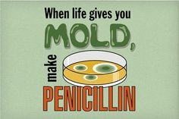
Penicillin: antibiotic
Chemicals produced by microorganisms which have action against other microorganisms
Discovered in mold Penicillium notatum by Alexander Fleming in 1928
Human trials in 1941
Used so much in WWII demand led to large-scale production

Slide 20
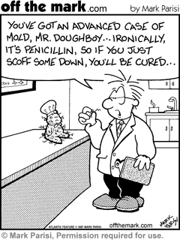
Penicillin: action of molecule (penicillin G)
Considered to be a dipeptide form of cysteine and valine
Nucleus of a 5-membered ring
Sulfur atom = thiazolidine
4-membered ring = beta-lactam

Slide 21
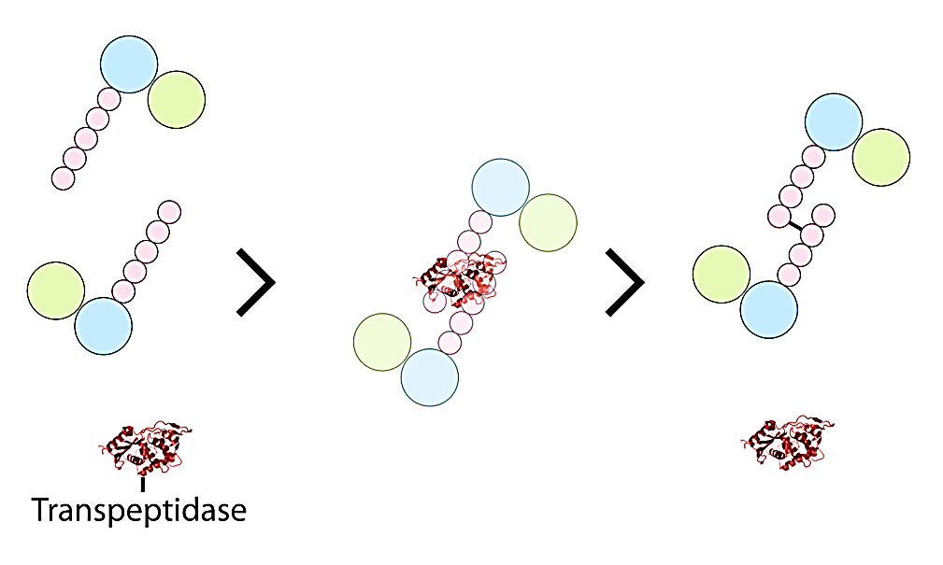
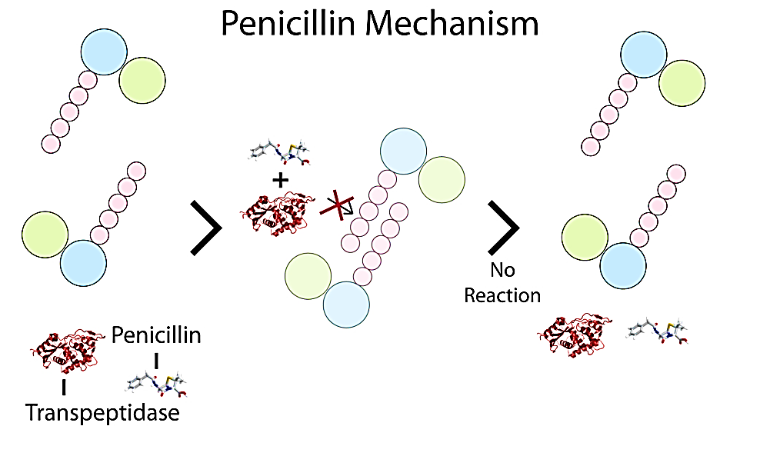
Penicillin: action of molecule (penicillin G)
Transpeptidase is an enzyme that aids in cell wall formation for bacteria
But penicillin inhibits this enzyme

Slide 22
Penicillin: action of molecule (penicillin G)
Strain on the bonds (being pushed to 90º)
Makes the ring relatively easy to break = key to activity
Blocks the cross-linking enzyme so cell wall does not connect well to cell membrane
Cell cannot support bacterium, so bursts and dies
Useful against a wide-range of bacteria
Breaks down in stomach acid = usu. Injection admin.
New ‘R’ groups added aids in pill form administration

Slide 23
Penicillin: antibiotic resistance
Some bacteria have an enzyme called penicillinase or beta-lactamase
Enzyme finds penicillin molecules and breaks ring
Makes molecule inactive
Responses to antibacterial resistance
Synthesis of other forms of penicillin
Methicillin or oxacillin
Have modified side chains to protect the ring from the enzyme
Legislation to protect use of antibiotics (prescript only)
Education of patients to complete full course of antibiotics

