Slide 1
Chapter 11.3-21.1:Spectroscopic identification of organic compounds
11.3: Analytical techniques can be used to determine the structure of a compound, analyze the composition of a substance, or determine the purity of a compound. Spectroscopic techniques are used in the structural identification of organic and inorganic compounds.
20.1: Although spectroscopic characterization techniques form the backbone of structural identification of compounds, typically no one techniques results in a full structural identification of a molecule

Slide 2
Analytical techniques
Qualitative analysis: detection of presence but not quantity of substance in mixture
Quantitative analysis: measurement of the quantity of a particular substance in a mixture
Structural analysis: description of how atoms are arranged in molecular structures

Slide 3
Structural analysis
Mass spectroscopy (MS): used to determine relative atomic & molecular masses. Fragmentation pattern can be “fingerprint”
Infrared spectroscopy (IR): used to identify bonds in a molecule
Nuclear magnetic resonance spectroscopy: used to show chemical environment of isotopes (H, C, P, F)
X-ray diffraction: used to identify atomic and molecular structure of a crystal, in which the crystalline atoms cause a beam of incident X-rays to diffract into many specific directions

Slide 4
Mass Spectroscopy
Recall from chapter 2
Mass spect charges the atoms to be + ions and detects specific ions’ mass
Used to find relative molecular mass of compound
If EF is known, molecular formula can be determined

Slide 5
Mass spectroscopy
Fragmentation patterns
High E e- bombard compound to knock off e- resulting in a cation:
X(g) + e⁻ → X⁺(g) + 2e⁻
Spectra results in fragmentation pattern that can give us a picture of complete molecule

Slide 6
Mass spectrum of ethanol
Where do these spikes come from?

Slide 7
Mass spectrum of ethanol

Slide 8
Mass spectrum of ethanol
Each fragmentation results in 1 ion keeping + charge
For breaking C-C bond, 2 possible outcomes

Slide 9
Mass spectrum of ethanol
Expected to be able to recognize mass fragments below (not memorize details from section 28 of data booklet)

Slide 10
Degree of Unsaturation or Index of Hydrogen Deficiency (IHD)
Measure of how many H₂ molecules are needed to convert molecule into saturated, non-cyclic molecule

Slide 11
EM spectrum and identifying organic molecules
EM spectrum is described by wavelength (λ) and frequency (ν)
c= νλ c = speed of light = 3.0 x 10⁸ ms⁻¹
Wavenumber = frequency of radiation is measured in number of waves per centimeter

Slide 12
EM spectrum and identifying organic molecules
Radio waves – gives info about environment of certain atoms
Infrared radiation – gives info about bonds in a molecule
Visible & UV light – gives info about E levels within atom/molecule
X rays – gives info about molecular and crystal structure

Slide 13
Infrared (IR) spectroscopy
Chemical bonds are like springs
Light atoms = vibrate at higher frequencies
Heavy atoms = vibrate at lower frequencies
IR energy can cause a bond to stretch or bend
Simple diatomics can only vibrate when bond is stretched (H-Cl highest freq, H-I lowest freq.)
Bond must be polar to interact with IR energy

Slide 14
IR spectroscopy
Use charts like this to determine the kinds of bonds a molecule contains

Slide 16
Nuclear Magnetic Resonance (NMR) Spectroscopy
Used to find shape & structure of molecules
Atoms w/ odd # protons spin like itty bitty bar magnets
¹H, ¹³C, ¹⁹F, ³¹P

Slide 17
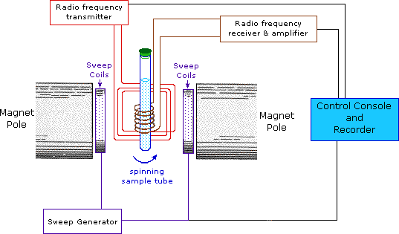
NMR Spectroscopy
Resonance: Field strength is varied until the radio waves have exact freq. to flip nuclei (spin other way)
Detected electronically and reported as a spectrum
Non-invasive
Get sample back

Slide 18
¹H NMR
Hydrogen nuclei can tell give information about where they are in a molecule
Chemical shift = position of H relative to the standard (section 27 of data booklet)
Tetramethylsilane is the standard
All H are same

Slide 20
Interpreting ¹H NMR
The two peaks show areas of protons
The height of the peaks show the relative abundance of the peaks (proportional)

Slide 21
Why tetramethylsilane?
All Hs are the same = 1 signal
Si
Has lower EN than Carbon
Si absorbs in a different part of the spectrum than C when bonded to H
Si(CH₃)₄
Has low boiling point
Is chemically inert (non-reactive)
Is soluble in most organic solvents

Slide 22
High-resolution ¹H NMR
Can show the difference in the spins of nuclei
Right: Hi-res ¹H NMR
Below: ¹H NMR

Slide 23
High-resolution ¹H NMR
Instead of one signal = 1 energy difference
2 signals are produced
Both are likely & have same intensity

Slide 24
High-resolution ¹H NMR
Protons bonded to same atom do not interact with each other (behave as group)
Protons on non-adjacent carbons do not typically interact with each other
The O-H single peak is ethanol does not split unless sample is pure
So the different possible positions in the -CH₃ in ethanal leads to 4 actual signals (CHO is affected by –CH₃)

Slide 25
X-ray Diffraction
X-rays are passed through a crystal
Scattered pattern of light is orderly based on interactions of e- in substance
Called a diffraction pattern

Slide 26
X-ray Diffraction: Interference
Constructive interference
Waves reinforce each other
Produces a high intensity region on screen
Destructive interference
Waves cancel each other
Produces a region of low intensity on screen

Slide 27
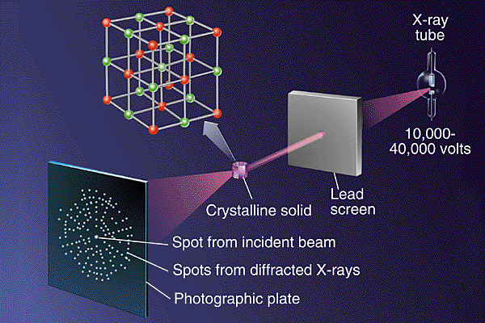

Slide 28
X-ray Diffraction
Monochromatic X-rays used
Sample in solid state
Diffraction pattern is based upon
Wavelength of incident radiation
Inter atomic distance
Relative atomic orientation
Angle of incidence

Slide 29
X-ray Diffraction
Contour lines connect points with the same electron density

